Slide 1


The Power of Appreciative Inquiry
Solving Problems by Looking at What's Going Right
& it possible use for the Centre for Pollination Studies
Dr John Mauremootoo
Notes:
The original 1987 article was written by David Cooperrider and Suresh Srivastva.
The study of what gives life to human systems when they are at their best – Diane Whitney

Slide 2
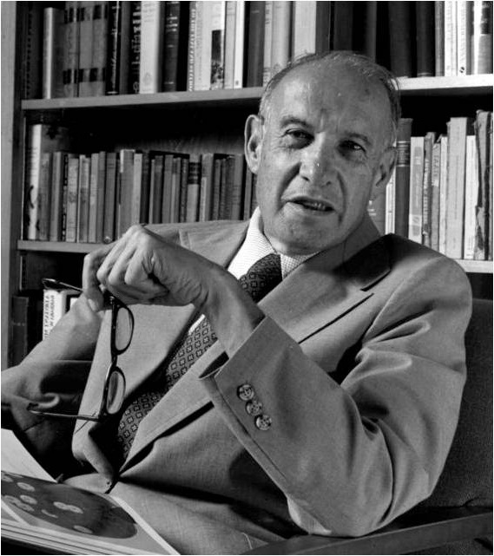
“The essence of management and leadership is simple and ageless. The task of leadership is to create an alignment of strengths in ways that make a system’s weaknesses irrelevant.“
Peter Drucker

Slide 3
“The essence of management and leadership is simple and ageless. The task of leadership is to create an alignment of strengths in ways that make a system’s weaknesses irrelevant.“
Peter Drucker

Slide 4
Objectives
To understand some principles behind AI
To understand the basic AI processes
To consider how AI could be used in the CPS

Slide 5
Warming up your appreciative “muscles”
EXERCISE
Look into the eyes of the person next to you and say three things that you appreciate about them – do this in turn
Notes:
Prius

Slide 6
Five Principles that underpin AI
Individuals give events their meaning
What you focus on expands
We are programmed to pay attention to negative aspects of a situation
We can override our programming by exercising our “appreciative muscles”
Words create worlds

Slide 7
Five AI Principles
Individuals give events their meaning
What you focus on expands
We are programmed to pay attention to negative aspects of a situation
We can override our programming by exercising our “appreciative muscles”
Words create worlds
Notes:
It’s how we relate to things that give things their meaning

Slide 8
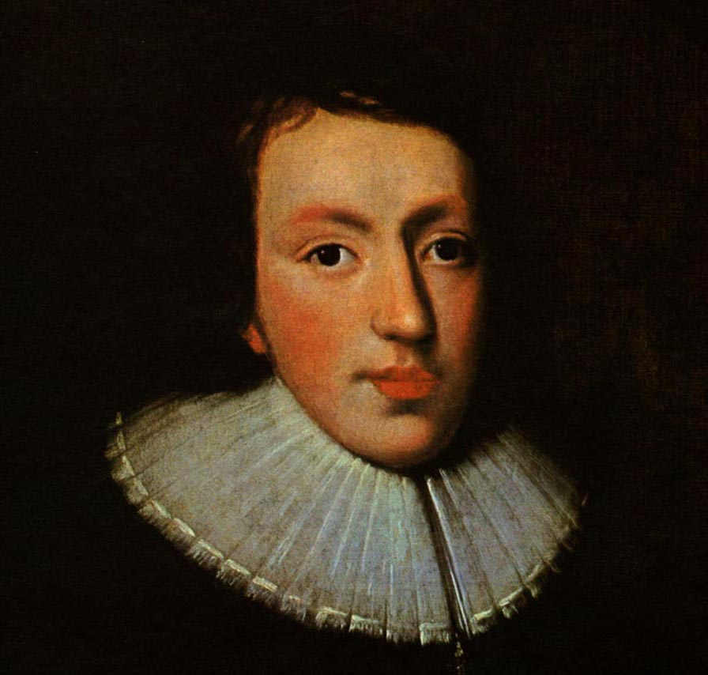
1. Individuals give events their meaning
“
The mind is its own place, and in itself can make a heaven of hell, a hell of heaven.
“
John Milton – English author & poet

Slide 9

1. Individuals give events their meaning

Slide 10
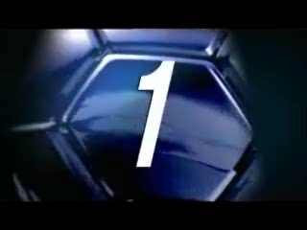
1. Individuals give events their meaning

Slide 11
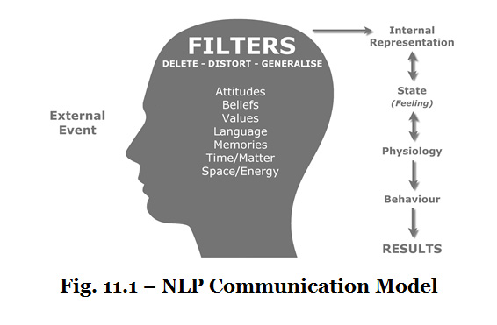
1. Individuals give events their meaning
External events are transformed into thoughts via our filters which delete, distort and generalise these events

Slide 12
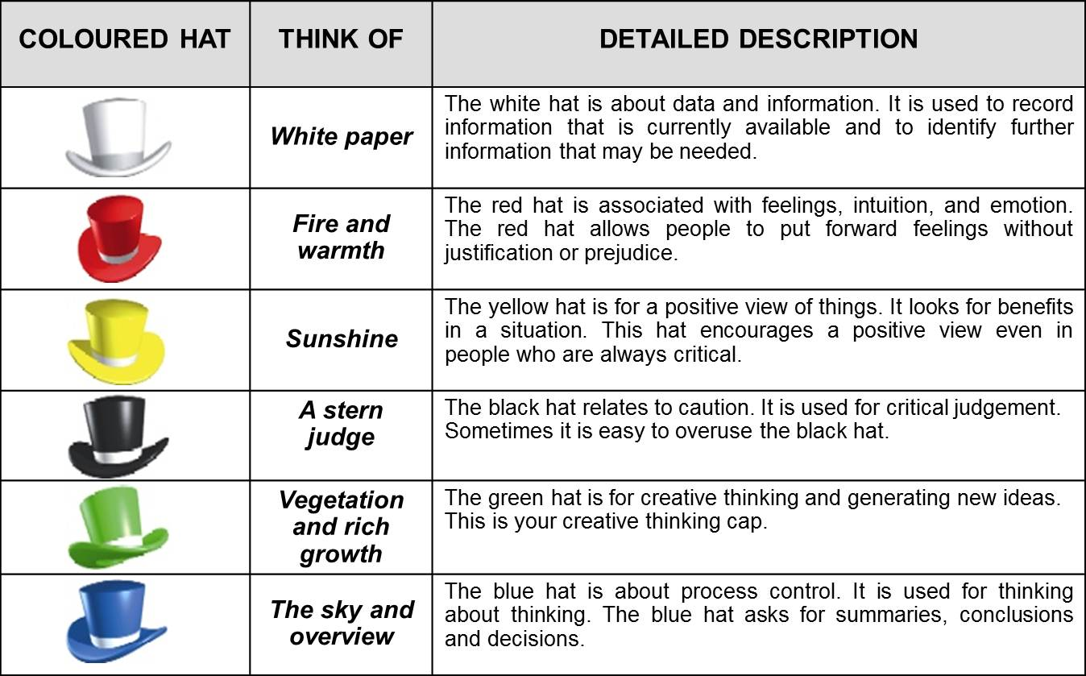
1. Individuals give events their meaning
Edward De Bono’s Six Thinking Hats
Just the Facts: What information do we have & what information do we need
Feelings, intuition & emotions: What do things mean for people, families and social groups?
Positivity: What can turn out for the best?
The Devil’s Advocate: Why something did not or will not work
Creativity, brainstorming: Throwing ideas on the table
Organising & planning: Organises, summarises, concludes & decides

Slide 13
1. Individuals give events their meaning
Edward De Bono’s Six Thinking Hats
Just the Facts: What information do we have & what information do we need
Feelings, intuition & emotions: What do things mean for people, families and social groups?
Positivity: What can turn out for the best?
The Devil’s Advocate: Why something did not or will not work
Creativity, brainstorming: Throwing ideas on the table
Organising & planning: Organises, summarises, concludes & decides

Slide 14
1. Individuals give events their meaning
Edward De Bono’s Six Thinking Hats
Just the Facts: What information do we have & what information do we need
Feelings, intuition & emotions: What do things mean for people, families and social groups?
Positivity: What can turn out for the best?
The Devil’s Advocate: Why something did not or will not work
Creativity, brainstorming: Throwing ideas on the table
Organising & planning: Organises, summarises, concludes & decides

Slide 15
1. Individuals give events their meaning
Edward De Bono’s Six Thinking Hats
Just the Facts: What information do we have & what information do we need
Feelings, intuition & emotions: What do things mean for people, families and social groups?
Positivity: What can turn out for the best?
The Devil’s Advocate: Why something did not or will not work
Creativity, brainstorming: Throwing ideas on the table
Organising & planning: Organises, summarises, concludes & decides

Slide 16
1. Individuals give events their meaning
Edward De Bono’s Six Thinking Hats
Just the Facts: What information do we have & what information do we need
Feelings, intuition & emotions: What do things mean for people, families and social groups?
Positivity: What can turn out for the best?
The Devil’s Advocate: Why something did not or will not work
Creativity, brainstorming: Throwing ideas on the table
Organising & planning: Organises, summarises, concludes & decides

Slide 17
1. Individuals give events their meaning
Edward De Bono’s Six Thinking Hats
Just the Facts: What information do we have & what information do we need
Feelings, intuition & emotions: What do things mean for people, families and social groups?
Positivity: What can turn out for the best?
The Devil’s Advocate: Why something did not or will not work
Creativity, brainstorming: Throwing ideas on the table
Organising & planning: Organises, summarises, concludes & decides

Slide 18
1. Individuals give events their meaning
Edward De Bono’s Six Thinking Hats
Just the Facts: What information do we have & what information do we need
Feelings, intuition & emotions: What do things mean for people, families and social groups?
Positivity: What can turn out for the best?
The Devil’s Advocate: Why something did not or will not work
Creativity, brainstorming: Throwing ideas on the table
Organising & planning: Organises, summarises, concludes & decides

Slide 19
Five AI Principles
Individuals give events their meaning
What you focus on expands
We are programmed to pay attention to negative aspects of a situation
We can override our programming by exercising our “appreciative muscles”
Words create worlds

Slide 20
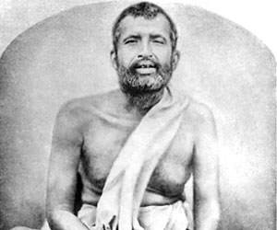
2. What you focus on expands
“
The winds of grace are always blowing, but you have to raise the sail.
“
Sri Ramakrishna - 19th-century Indian mystic
Notes:
A mystic is somebody who pursues truth beyond that normally associated with human experience

Slide 21
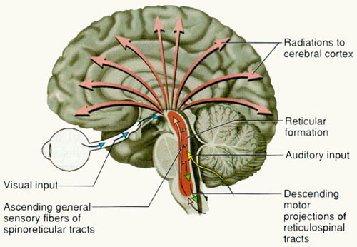
2. What you focus on expands
The Reticular Activating System: the brain’s gatekeeper
Notes:
The gatekeeper to the consciousness.
The RAS is a network of nerve fibers that originates in the medulla oblongata (brain stem area) and proceeds up through the midbrain into the neocortex, the place where thought is processed. The task of the RAS is to detect new and novel stimuli. When something new or different is perceived in the environment, the RAS alerts the brain to possible danger by causing an ''arousal state.'' If a stimulus, such as a sound, is repetitive in nature, the RAS calms the brain and causes it to enter various peaceful states, depending upon the nature of the stimulus.

Slide 22
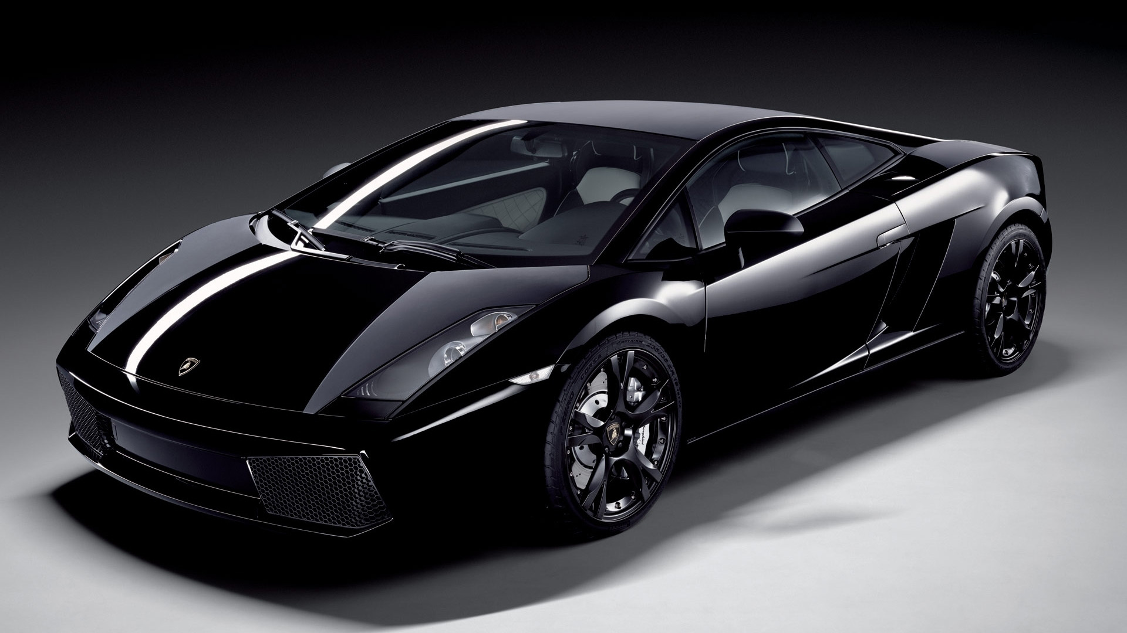
2. What you focus on expands
The Reticular Activating System and my car
Notes:
Lamborghini

Slide 23
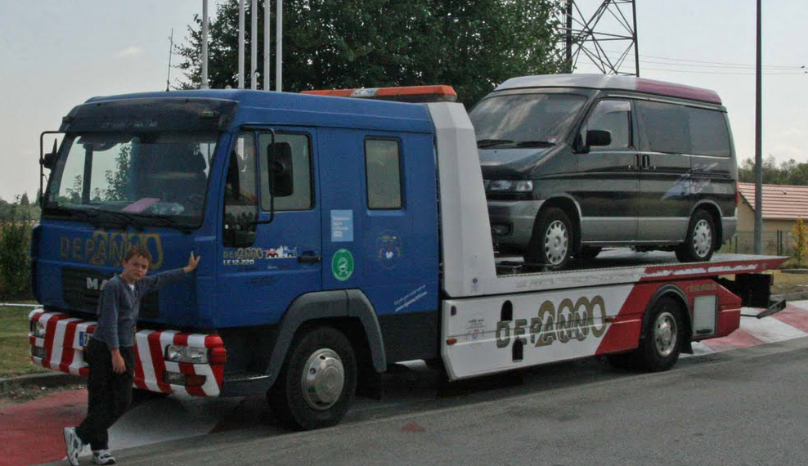
2. What you focus on expands
The Reticular Activating System and my car
Notes:
Mazda Bongo

Slide 24
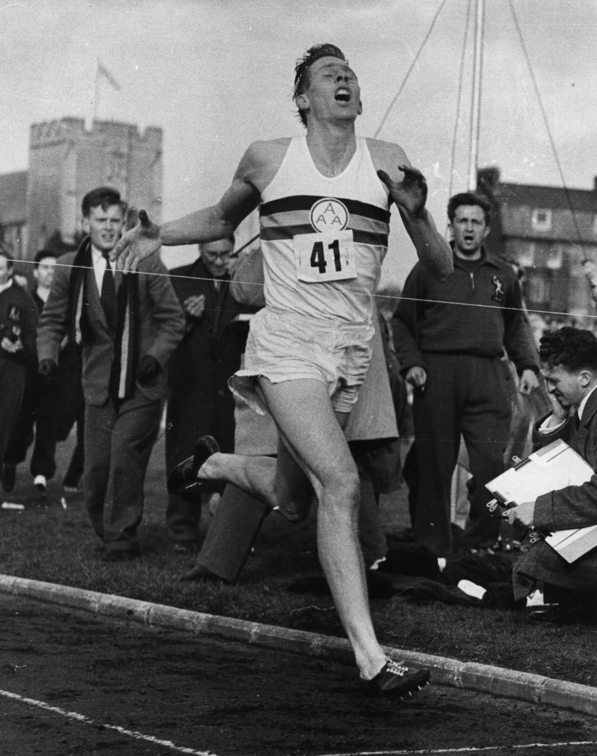
2. What you focus on expands
This includes possibilities
On May 6th 1954 Roger Banister became the first person to run a mile in under 4 minutes a feat considered impossible by many.
Banister’s record lasted only 46 days and within one year thirty seven other runners had broken the 4-minute barrier.
Notes:
Give two examples of the effects of the RAS in your daily life and one that concerns your work for the CPS

Slide 25
2. What you focus on expands
EXERCISE
In pairs list a total of four examples of things that you have started to give attention to that were previously “hidden in plain sight “
Notes:
Prius

Slide 26
Five AI Principles
Individuals give events their meaning
What you focus on expands
We are programmed to pay attention to negative aspects of a situation
We can override our programming by exercising our “appreciative muscles”
Words create worlds

Slide 27
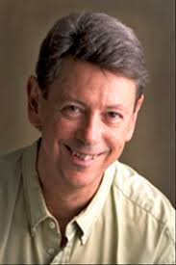
3. We are programmed to pay attention to negative aspects of a situation
“
Our negative experiences stick to us like Velcro, while our positive experiences slide right off us like Teflon.
“
Dr Rick Hanson
Neuropsychologist & author of Hardwiring happiness

Slide 28

3. We are programmed to pay attention to negative aspects of a situation
Notes:
Study after study shows that the desire to avoid pain (fear) is usually the more powerful of the two forces. An illustrative study was carried out by Professor Baba Shiv of Stamford University (<<URL>>). Shiv gave participants $20. They had the choice of whether to bet or not bet $1 on 20 coin tosses. Each losing bet would cost $1 while each winning bet would make $1.50. Logically you should bet every time but that is not what actually happened. The participants refused to bet on many occasions and this reluctance grew with each coin toss. On average the participants ended up with only $22.80 compared to the predicted average of $25 if they had bet on every coin toss.

Slide 29

3. We are programmed to pay attention to negative aspects of a situation
Notes:
Study after study shows that the desire to avoid pain (fear) is usually the more powerful of the two forces. An illustrative study was carried out by Professor Baba Shiv of Stamford University (<<URL>>). Shiv gave participants $20. They had the choice of whether to bet or not bet $1 on 20 coin tosses. Each losing bet would cost $1 while each winning bet would make $1.50. Logically you should bet every time but that is not what actually happened. The participants refused to bet on many occasions and this reluctance grew with each coin toss. On average the participants ended up with only $22.80 compared to the predicted average of $25 if they had bet on every coin toss.

Slide 30
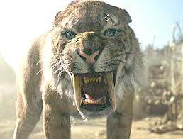
3. We are programmed to pay attention to negative aspects of a situation
We are more motivated to avoid pain than pursue pleasure
Notes:
Study after study shows that the desire to avoid pain (fear) is usually the more powerful of the two forces. An illustrative study was carried out by Professor Baba Shiv of Stamford University (<<URL>>). Shiv gave participants $20. They had the choice of whether to bet or not bet $1 on 20 coin tosses. Each losing bet would cost $1 while each winning bet would make $1.50. Logically you should bet every time but that is not what actually happened. The participants refused to bet on many occasions and this reluctance grew with each coin toss. On average the participants ended up with only $22.80 compared to the predicted average of $25 if they had bet on every coin toss.

Slide 31
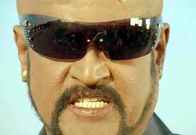
3. We are programmed to pay attention to negative aspects of a situation
“Let’s fix what’s wrong and let the strengths take care of themselves” Gallup Poll (survey of 1.5 million people)
Theory of change: The way to effectiveness is to focus on weakness
Notes:
People do more to avoid pain than gain pleasure – that’s why negative political campaigning works so well.
Proverbs: Better the devil you know and a bird in the hand is worth two in the bush

Slide 32
Five AI Principles
Individuals give events their meaning
What you focus on expands
We are programmed to pay attention to negative aspects of a situation
We can override our programming by exercising our “appreciative muscles”
Words create worlds

Slide 33
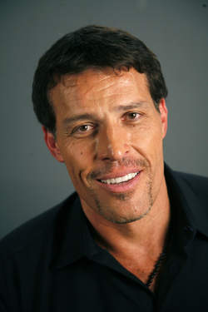
4. We can override our programming by exercising our “appreciative muscles”
“
One important measure of a person’s intelligence is the way in which they use their fabric of references. Do you craft a curtain to hide behind, or do you fashion a magic carpet that will carry you to unequalled heights? Do you consciously dig through your life experience and pull out those memories that empower you most on a consistent basis?
“
Tony Robbins – Best selling author & self-empowerment guru

Slide 34
4. We can override our programming by exercising our “appreciative muscles”
“
One important measure of a person’s intelligence is the way in which they use their fabric of references. Do you craft a curtain to hide behind, or do you fashion a magic carpet that will carry you to unequalled heights? Do you consciously dig through your life experience and pull out those memories that empower you most on a consistent basis?
“
Tony Robbins – Best selling author & self-empowerment guru

Slide 35
4. We can override our programming by exercising our “appreciative muscles”
Practice gratitude
Ask appreciative questions
Observe the feelings and thoughts that come to you
Cultivate stillness
Embrace uncertainty
Be of service

Slide 36
4. We can override our programming by exercising our “appreciative muscles”
Practice gratitude
EXERCISE
List three things you are grateful for today
Notes:
“Yet it’s easy to take things for granted. How much time during the day do you actually focus on gratitude, compared to the time you spend thinking about the problems in your life? We act as if gratitude and appreciation are our good china and our fancy tablecloth and bring them out only on really special occasions.” – Marci Shimoff.

Slide 37
4. We can override our programming by exercising our “appreciative muscles”
Ask appreciative questions
What am I grateful for?
What’s already working?
What’s been your best experience in relation to (desired result)?
What enabled these good experiences to happen?
Where is the solution already happening, if only in part?
What strengths/qualities/skills/resources/ do you have that will help?
How can I enjoy the process while making things the way I want to make them?
What are my wishes?
What is not working yet?
Notes:
Be easy to impress & hard to offend e.g. looking at beautiful views every day

Slide 38
4. We can override our programming by exercising our “appreciative muscles”
Ask appreciative questions
EXERCISE
Divide into pairs and take turns to conduct an appreciative interview as outlined on the sheet you have been given

Slide 39

4. We can override our programming by exercising our “appreciative muscles”
Observe the feelings and thoughts that come to you
That’s just a thought about …
This is what I am feeling when…
Don’t jump to confusions
Notes:
All feelings come from the same source – befriend all feelings. In her household anger was a feeling that only her dad could openly express. When she felt anger she had to go to her room until she was good!!
Difference between conscious and sub-conscious: The feelings get there first. Sharing without defending. No transformative value to criticism.
Gay Hendricks – Banishing blame and criticism. How do you do this without repressing stuff? Turn it into a no-blame situation. Share my feelings!! Eliminate the you. This is what I am feeling when … What is blame and what is feedback.
Every time I noticed that I was caught up in my thoughts, I would use the following little mantra: 'Ah, that's just a thought about ...' such as, 'Ah, that's just a thought about having too much to do' or 'Ah, that's just a thought about my deadline for this book.' And you know what? It totally takes the sting out of them.
Break the habit of reacting to your thinking, and you'll automatically stop yourself from being pulled this way and that by any number of the 50,000 or so thoughts that we all have each day.
Is it any wonder that we sometimes struggle to make sense of it all if we are being pulled out of shape in 50,000 different directions every day? Actually, the research shows that it's not really 50,000 thoughts but instead around 2,000 unique thoughts with lots of repeats, which I think is even worse.
But you need to pay attention. What is energising you and what is draining you? Mindfulness is the foundation. Understanding expectations. “you’re expecting me to be you and you are expecting me to be me!”
All feelings come from the same source – befriend all feelings. In her household anger was a feeling that only her dad could openly express. When she felt anger she had to go to her room until she was good!!
Difference between conscious and sub-conscious: The feelings get there first. Sharing without defending. No transformative value to criticism.
Gay Hendricks – Banishing blame and criticism. How do you do this without repressing stuff? Turn it into a no-blame situation. Share my feelings!! Eliminate the you. This is what I am feeling when … What is blame and what is feedback.

Slide 40
4. We can override our programming by exercising our “appreciative muscles”
Cultivate stillness
EXERCISE
Sixteen seconds to clarity
Notes:
As we continue to meditate and spend time in stillness and silence, each day becomes more comfortable; restful awareness becomes more and more our natural state; and greater clarity begins to unfold. It becomes less important to defend our point of view because we see greater possibilities, and creative solutions emerge to once-daunting challenges. Constrictions magically open up, and every moment becomes more expansive.

Slide 41
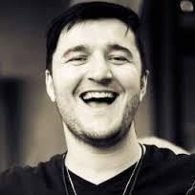
4. We can override our programming by exercising our “appreciative muscles”
Embrace uncertainty
“
The quality of my life is the quality of my relationship with uncertainty.
“
Mastin Kipp – Founder of the Daily Love.com
Notes:
Marci Shimoff, in her book happiness for no reason, recalls a story that speaks to the power of words. She was on an airplane going to a conference with her good friends, Stewart and Joan Emery, leading lights in the human potential movement. They were talking about the concept of happiness— somethingshe does a lot— when Stewart turned to her and said in his charming Australian accent, “Marci, do you know what Thomas Jefferson really meant by the pursuit of happiness?” Stewart, the coauthor of Success Built to Last, knows many fascinating and often obscure facts. Back in Jefferson’s day, he explained, the common usage of the word “pursue” was not “to chase after.” In 1776, to pursue something meant to practice that activity, to do it regularly, to make a habit of it.

Slide 42
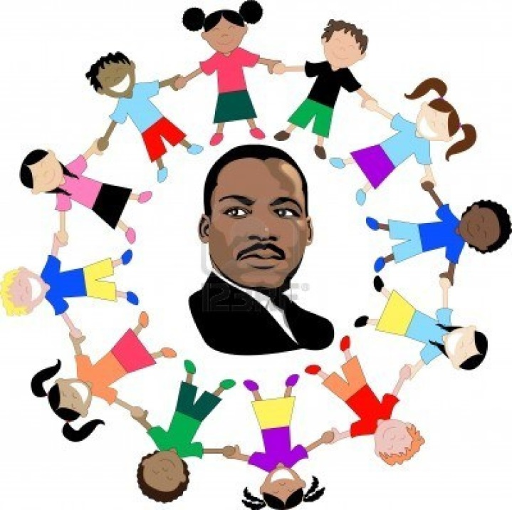
4. We can override our programming by exercising our “appreciative muscles”
“
Make a career of humanity, commit yourself to the noble struggle for equal rights. You will make a greater person of yourself, a greater nation of your country, and a finer world to live in.
“
Dr Martin Luther King – American civil rights leader
Be of Service
Notes:
Marci Shimoff, in her book happiness for no reason, recalls a story that speaks to the power of words. She was on an airplane going to a conference with her good friends, Stewart and Joan Emery, leading lights in the human potential movement. They were talking about the concept of happiness— somethingshe does a lot— when Stewart turned to her and said in his charming Australian accent, “Marci, do you know what Thomas Jefferson really meant by the pursuit of happiness?” Stewart, the coauthor of Success Built to Last, knows many fascinating and often obscure facts. Back in Jefferson’s day, he explained, the common usage of the word “pursue” was not “to chase after.” In 1776, to pursue something meant to practice that activity, to do it regularly, to make a habit of it.

Slide 43
Five AI Principles
Individuals give events their meaning
What you focus on expands
We are programmed to pay attention to negative aspects of a situation
We can override our programming by exercising our “appreciative muscles”
Words create worlds

Slide 44
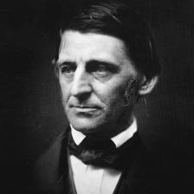
5. Words create worlds
“
Watch your thoughts for they become words,
watch your words for they become actions,
watch your actions, for they become habits,
watch your habits for they become your character,
watch your character for it becomes your destiny.
“
Ralph Waldo Emerson - American essayist, lecturer, and poet

Slide 45
5. Words create worlds
Our representation of the world is manifested in the words we use.
Toxic words and antidotes
Toxic words | Antidote
I’ll try
I will or I won’t

Slide 46
5. Words create worlds
Our representation of the world is manifested in the words we use.
Toxic words and antidotes
Toxic words | Antidote
I can’t
I cannot… yet

Slide 47
5. Words create worlds
Our representation of the world is manifested in the words we use.
Toxic words and antidotes
Toxic words | Antidote
Why me?
How can I use this?

Slide 48
5. Words create worlds
Our representation of the world is manifested in the words we use.
Toxic words and antidotes
Toxic words | Antidote
I’m ok because
I’m ok and

Slide 49
5. Words create worlds
Our representation of the world is manifested in the words we use.
Toxic words and antidotes
Toxic words | Antidote
Oh no I’m really not…
Thank you

Slide 50
5. Words create worlds
Our representation of the world is manifested in the words we use.
Toxic words and antidotes
Toxic words | Antidote
I’ll try | I will or I won’t
I can’t | I cannot …yet
Why me? | How can I use this?
I’m ok because | I’m ok and
Oh no I’m really not… | Thank you

Slide 51
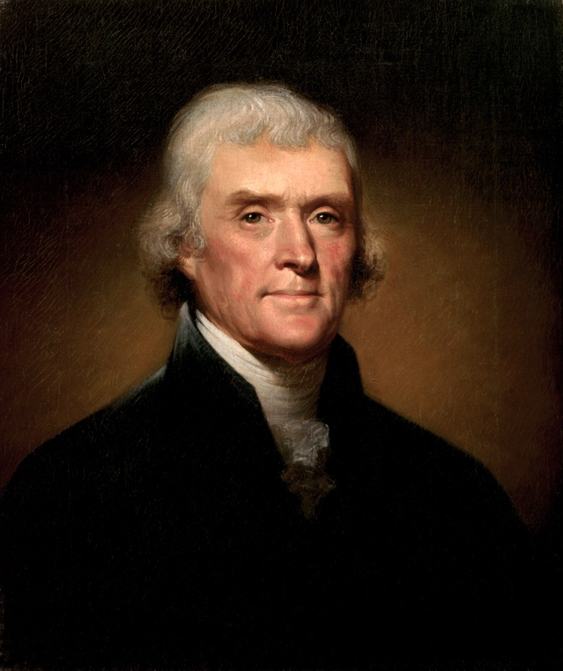
5. Words create worlds
“
We hold these truths to be self-evident, that all men are created equal, that they are endowed by their Creator with certain unalienable Rights, that among these are Life, Liberty and the pursuit of Happiness.
“
Thomas Jefferson – American founding father, President and principal author of the American Declaration of Independence
Notes:
Marci Shimoff, in her book happiness for no reason, recalls a story that speaks to the power of words. She was on an airplane going to a conference with her good friends, Stewart and Joan Emery, leading lights in the human potential movement. They were talking about the concept of happiness— something she does a lot— when Stewart turned to her and said in his charming Australian accent, “Marci, do you know what Thomas Jefferson really meant by the pursuit of happiness?” Stewart, the coauthor of Success Built to Last, knows many fascinating and often obscure facts. Back in Jefferson’s day, he explained, the common usage of the word “pursue” was not “to chase after.” In 1776, to pursue something meant to practice that activity, to do it regularly, to make a habit of it.
The trick is to realize that keeping yourself in a good place should be your most fundamental daily goal.

Slide 52
5. Words create worlds
“
We hold these truths to be self-evident, that all men are created equal, that they are endowed by their Creator with certain unalienable Rights, that among these are Life, Liberty and the pursuit of Happiness.
“
Thomas Jefferson – American founding father, President and principal author of the American Declaration of Independence
Notes:
Marci Shimoff, in her book happiness for no reason, recalls a story that speaks to the power of words. She was on an airplane going to a conference with her good friends, Stewart and Joan Emery, leading lights in the human potential movement. They were talking about the concept of happiness— something she does a lot— when Stewart turned to her and said in his charming Australian accent, “Marci, do you know what Thomas Jefferson really meant by the pursuit of happiness?” Stewart, the coauthor of Success Built to Last, knows many fascinating and often obscure facts. Back in Jefferson’s day, he explained, the common usage of the word “pursue” was not “to chase after.” In 1776, to pursue something meant to practice that activity, to do it regularly, to make a habit of it.
The trick is to realize that keeping yourself in a good place should be your most fundamental daily goal.

Slide 53
5. Words create worlds
EXERCISE
Reword these topics so that they expressed in an empowering way
Reducing negative leadership habits
Eliminating gender discrimination at work
Reducing customer complaints
Rehabilitating depressed communities
Fighting information bottlenecks
Tackling rural poverty

Slide 54
The Process of Appreciative Inquiry
The 4-D Cycle
Define – choose an affirmative topic
Discover – appreciating the best aspects of existing experience
Dream – Envisaging the future
Design – Planning = sorting, sifting and prioritising
Deliver – Systematic application of AI to the entity or process under consideration

Slide 55
An overview of Appreciative Inquiry
Thanks to Ken Long
Espoused values
What we say we do
Vs
Lived values
What we do
Choose an affirmative topic
Such as:
Inspiring & appreciative leadership
Positive cross-gender working relationships
Exceptional customer service
Vibrant communities
Timely access to useful information
Win-win partnerships
Financial sustainability
Best
worst

Slide 56
An overview of Appreciative Inquiry
Thanks to Ken Long
Espoused values
What we say we do
Vs
Lived values
What we do
Best
worst

Slide 57
An overview of Appreciative Inquiry
Thanks to Ken Long
Espoused values
What we say we do
Vs
Lived values
What we do
Best
Avg
worst

Slide 58
An overview of Appreciative Inquiry
Thanks to Ken Long
Espoused values
What we say we do
Vs
Lived values
What we do
Best
Avg
Typical area for focused on:
What went wrong?
What to fix?
Who’s to blame?
worst

Slide 59
An overview of Appreciative Inquiry
Thanks to Ken Long
Espoused values
What we say we do
Vs
Lived values
What we do
Best
What if we focused on:
What is going right?
What to do more of?
Who’s to praise?
Avg
Typical area for focused on:
What went wrong?
What to fix?
Who’s to blame?
worst

Slide 60
An overview of Appreciative Inquiry
Espoused values
What we say we do
Vs
Lived values
What we do
Appreciative Inquiry focus
Raise the human, emotional positive, life-affirming energy
Reinforce social networks
Whole > sum of parts
More time on positives, less time available for negatives
Taking “the high road”
Best
What if are focused on:
What is going right?
What to do more of?
Who’s to praise?
Avg
Typical area for focused on:
What went wrong?
What to fix?
Who’s to blame?
worst

Slide 61
An overview of Appreciative Inquiry
Thanks to Ken Long
Espoused values
What we say we do
Vs
Lived values
What we do
Appreciative Inquiry focus
Raise the human, emotional positive, life-affirming energy
Reinforce social networks
Whole > sum of parts
More time on positives, less time available for negatives
Taking “the high road”
Best
What if are focused on:
What is going right?
What to do more of?
Who’s to praise?
Avg
Some Qualities of Appreciative Inquiry
Seeing the inherent potential within a situation
The capacity to learn from the things you fear
To choose your attitude in a given circumstance
Finding a breakthrough, a valuable solution hidden in the present
Working directly on behaviours in order to change
worst

Slide 62
An overview of Appreciative Inquiry
Thanks to Ken Long
Espoused values
What we say we do
Vs
Lived values
What we do
Appreciative Inquiry focus
Raise the human, emotional positive, life-affirming energy
Reinforce social networks
Whole > sum of parts
More time on positives, less time available for negatives
Taking “the high road”
Best
Solicit positive stories:
Ask appreciative questions
Map the stories
Find themes
These are the best “lived values”
Build our better future
What if are focused on:
What is going right?
What to do more of?
Who’s to praise?
Avg
Some Qualities of Appreciative Inquiry
Seeing the inherent potential within a situation
The capacity to learn from the things you fear
To choose your attitude in a given circumstance
Finding a breakthrough, a valuable solution hidden in the present
Working directly on behaviours in order to change
worst

Slide 63
The Appreciative Inquiry Process
Our
Better
Future
Values
Themes
Stories
Define
Choose an
affirmative
topic
Theme | Value 1 | Value 2
Leadership
Communication
Incentives
Best
Action steps
Avg
Resources
Outputs
Our
Better
Present
Outcomes
worst

Slide 64
The Appreciative Inquiry Process
Our
Better
Future
Define
Choose an
affirmative
topic
Theme | Value 1 | Value 2
Leadership
Communication
Incentives
Discover
Action steps
Resources
Outputs
Our
Better
Present
Outcomes

Slide 65
The Appreciative Inquiry Process
Dream
Define
Choose an
affirmative
topic
Theme | Value 1 | Value 2
Leadership
Communication
Incentives
Discover
Action steps
Resources
Outputs
Our
Better
Present
Outcomes

Slide 66
The Appreciative Inquiry Process
Dream
Define
Choose an
affirmative
topic
Design
Discover
Our
Better
Present

Slide 67
The AI 4-D Model
Dream
Define
Choose an
affirmative
topic
Design
Discover
Deliver

Slide 68
The Process of Appreciative Inquiry
The 4-D Cycle
Define – choose an affirmative topic
Discover – appreciating the best aspects of existing experience
Dream – Envisaging the future
Design – Planning = sorting, sifting and prioritising
Deliver – Systematic application of AI to the entity or process under consideration

Slide 69
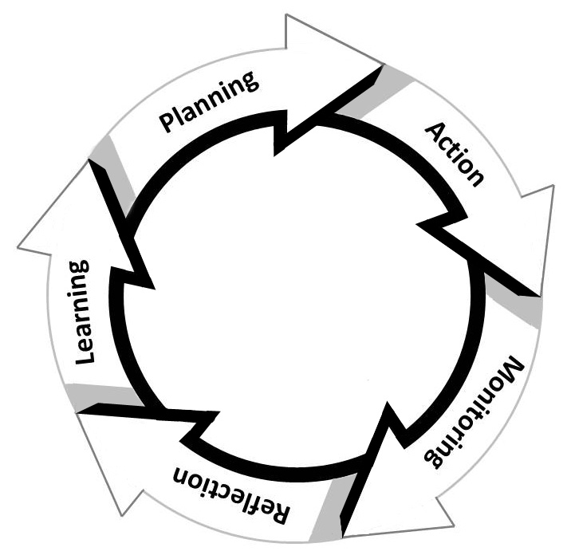
Notice any Parallels?
The Action Learning Cycle

Slide 70
Notice any Parallels?
Design
The Action Learning Cycle
Dream
Deliver
Discover
& Appreciative inquiry

Slide 71
Six basic human needs and AI’s empowering potential
Basic Human Needs | Powers unleashed by AI
1. Certainty
Power to be heard & supported
2. Uncertainty
Power to dare
3. Significance
Power to be known
4. Connection / love
Power to work in a community
5. Growth
Power to continually develop
6. Contribution /
Service
Power to contribute to a goal
Bigger than yourself

Slide 72
Appreciative Inquiry and CPS
EXERCISE
How could Appreciative Inquiry help the CPS?

Slide 73
Some final thoughts

Slide 74
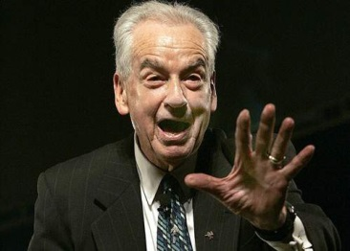
Practice
“
People often say that motivation doesn't last. Well, neither does bathing . . . that's why we recommend it daily.
“
Zig Zagler – Motivational speaker

Slide 75
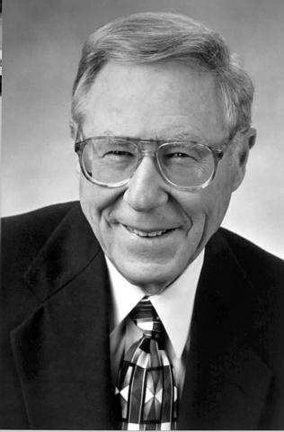
Practice… & teach
“
We Learn… 10% of what we read
20% of what we hear
30% of what we see
50% of what we see and hear
70% of what we discuss with others
80% of what we experience personally
95% of what we teach to someone else.
“
Dr William Glasser – author of Every Student can Succeed

Slide 76
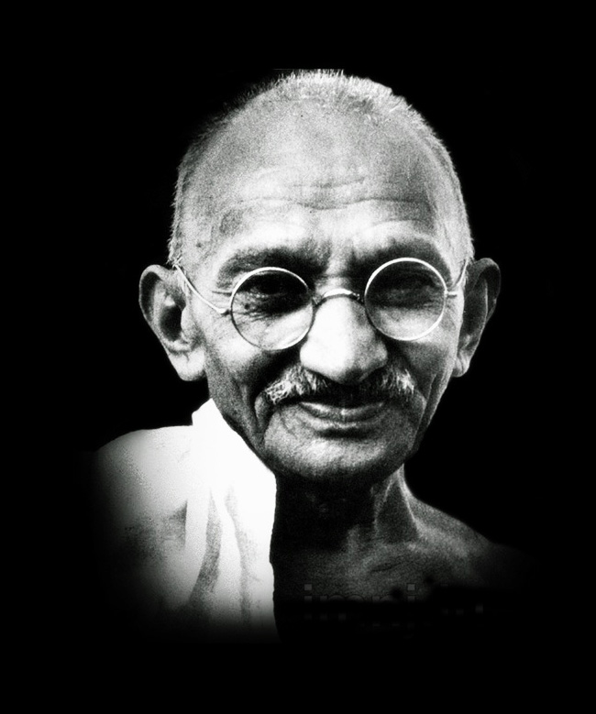
AND FINALLY
Be of service
“
Be the change you wish to see in the world.
“
Mahatma Gandhi
2 October 1869 – 30 January 1948

Slide 77
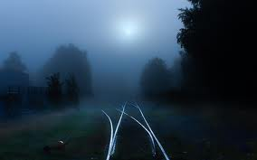
I appreciate your participation
Reference: Diana Whitney & Amanda Trosten-Bloom (2010). The Power of Appreciative Inquiry: A practical guide to positive change. Berrett-Koehler Publishers.

