Slide 1
CPS Learning Webinar to share PME insights for the Darwin Initiative Project
Enhancing the relationship between people and pollinators in Eastern India

Slide 2
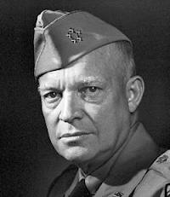
plans are useless but planning is indispensable
Dwight D. Eisenhower
Notes:
Wikipedia entry: Dwight David "Ike" Eisenhower (October 14, 1890 – March 28, 1969) was the 34th President of the United States from 1953 until 1961. He had previously been a five-star general in the United States Army during World War II, and served as Supreme Commander of the Allied Forces in Europe; he had responsibility for planning and supervising the invasion of North Africa in Operation Torch in 1942–43 and the successful invasion of France and Germany in 1944–45, from the Western Front. In 1951, he became the first supreme commander of NATO.

Slide 3
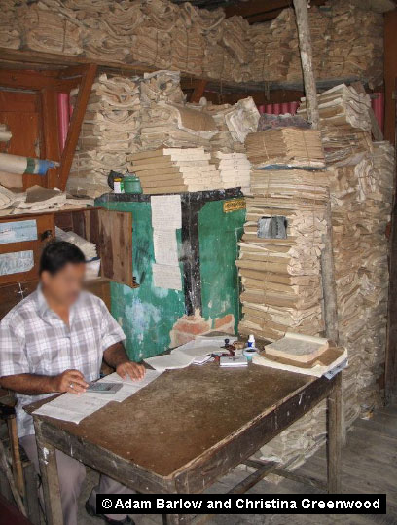
Notes:
An example of what we do not want!! File keeping not information management

Slide 4
Facilitation Approach
Everyone can participate
One speaks, all listen
Value each other’s ideas
No smoking
Mobile phones on silent
Respect each other by being on time
Questions any time (answers may come later)
…Other?

Slide 5
AN OVERVIEW OF PME

Slide 6
Exercise: What is M&E?
INDIVIDUAL EXERCISE
Each person writes a single word that describes what they feel when they hear the word M&E:
Write up to five words per person

Slide 7
What is M&E?
Monitoring is the ongoing, systematic collection of data to provide management and the main stakeholders of an intervention with indications of the extent of progress and achievement of objectives and progress in the use of allocated funds.
Evaluation is a periodic systematic data-based assessment to provide useful feedback about an intervention (programme policy, project, etc.) for its intended users. The intervention is evaluated on stated criteria, e.g. relevance, efficiency, effectiveness, sustainability and impact.
Notes:
Emphasise the fact that in multi-stakeholder projects operating in complexity there is considerable overlap between planning, monitoring and evaluation.

Slide 8
Objectives
Objectives of the Webinar:
To establish a shared understanding within the Calcutta University Team of the rationale behind the use of a PME (planning, monitoring and evaluation) system that maximises learning and is responsive to changes within the project’s spheres of control, influence and concern.
To exchange sufficient information to effectively operationalise the system.

Slide 9
Overview
To establish a shared understanding within the Calcutta University Team of the rationale behind the use of a PME (planning, monitoring and evaluation) system that maximises learning and is responsive to changes within the project’s spheres of control, influence and concern:
  What PME is
  Why a PME system is needed (uses)
  Who needs a PME system (users)
  Who is involved in PME
  When we monitor and evaluate
  What we monitor and evaluate
  How we monitor and evaluate
To exchange sufficient information to effectively operationalise the system
To implement a system that can contribute to positive, significant and sustainable change on the ground.

Slide 10
Webinar Agenda
10:15 An overview of PME – establish shared understanding
      What is M&E?
      Why monitor?
      For whom do we monitor?
      Who is involved with monitoring and how does it work?
      What do we monitor?
      The challenge of planning, monitoring and evaluating for Outcomes and Impacts?
14:30 CPS Monitoring Processes
      Monitoring inputs
      Monitoring activities and outputs
      Monitoring outcomes
15:45 Webinar Recap, Reflection, Outstanding issues and Next Steps
16:15 Close of webinar

Slide 11
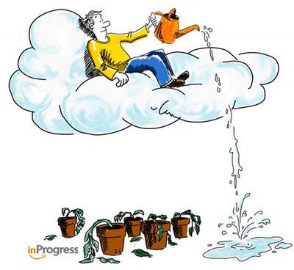
Why Monitor? (uses & users)
GROUP EXERCISE
What does this picture illustrate about monitoring?
What can be done to improve this situation?

Slide 12
M&E Uses
EXERCISE FOR PAIRS
Write to five reasons for undertaking M&E

Slide 13
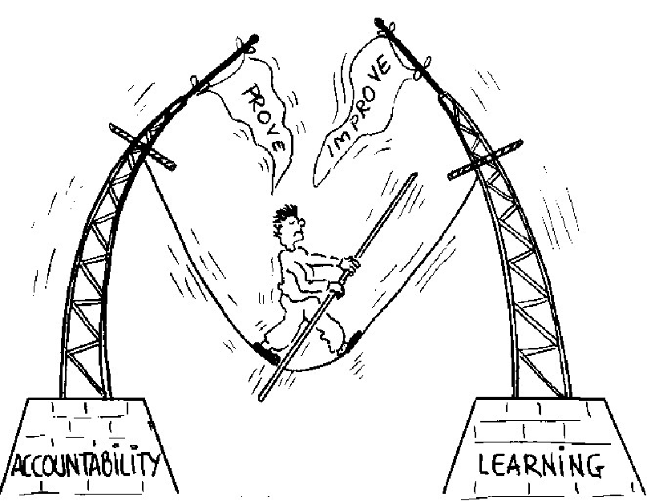
Accountability & Learning
Notes:
Upward and downward accountability and the tension between the two

Slide 14
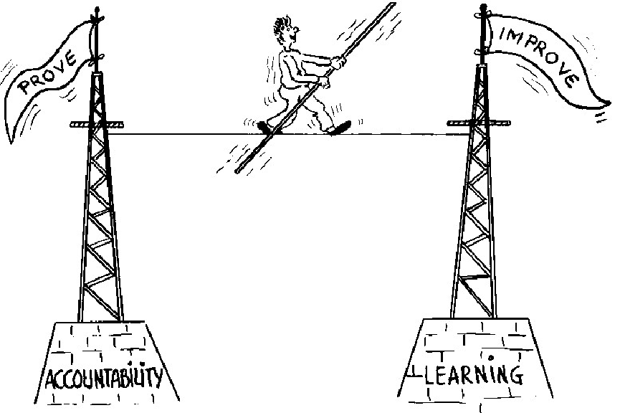
The M&E Balancing Act

Slide 15
M&E Users
For whom do we monitor?
EXERCISE
Brainstorm: Which user groups do we monitor for?

Slide 16
Who is involved in monitoring
& how does it work?
A project has just organised a training course with a local community. The facilitators compiled information about the course – cost, number of participants, number of manuals and the results of the course evaluation. Most participants stated that the training was informative but that they did not know how to use the knowledge in their daily work.
The cards you have been given represent states of the monitoring process.
Organise the cards into a logical monitoring time sequence. Explain your results

Slide 17





Who is involved in monitoring?
Field staff
Community
Project Implementation Team
Management Team of Project Implementing Organisation
Donors
Notes:
1= Field Staff; 2 = Community; 3 = Project Implementation Team; 4 = Management Team of Project Implementing Organisation; 5 = Donors

Slide 18
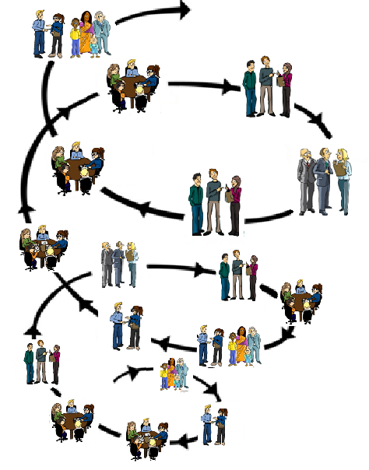
Action → Reflection → Learning → Planning
Putting the P in PME
Notes:
Michael Quinn Patton, Developmental evaluation p134 - "A primary strategy for coping with uncertainty applies to both programs and evaluations and the interactions between the two: shorten and speed up feedback. The longer the time horizon the greater the uncertainty. Long term outcomes and impacts are especially uncertain.“

Slide 19
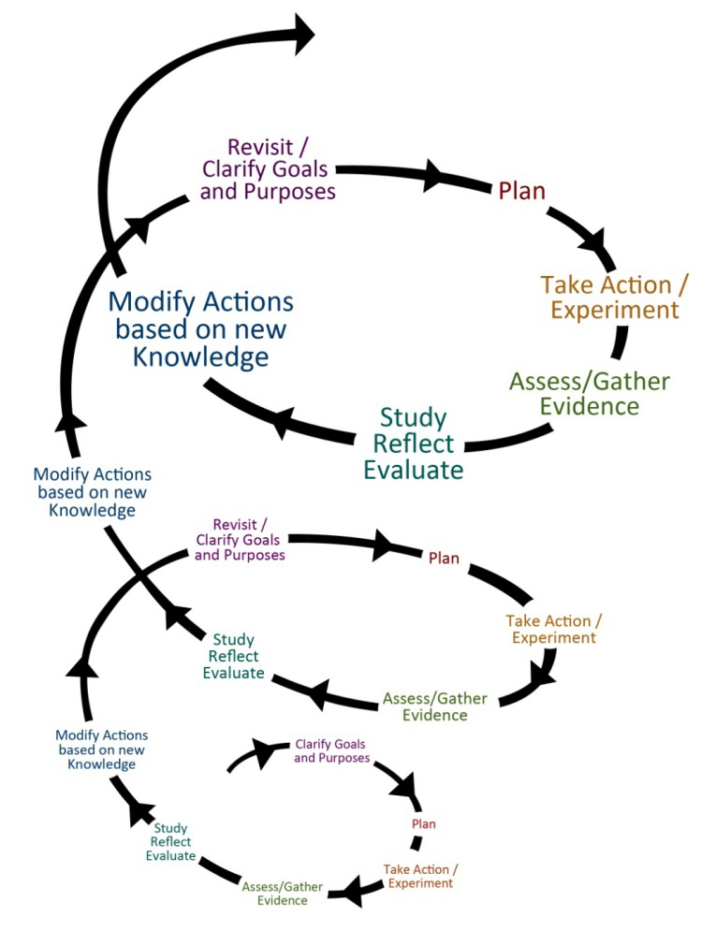
Action → Reflection → Learning → Planning
Putting the P in PME

Slide 20
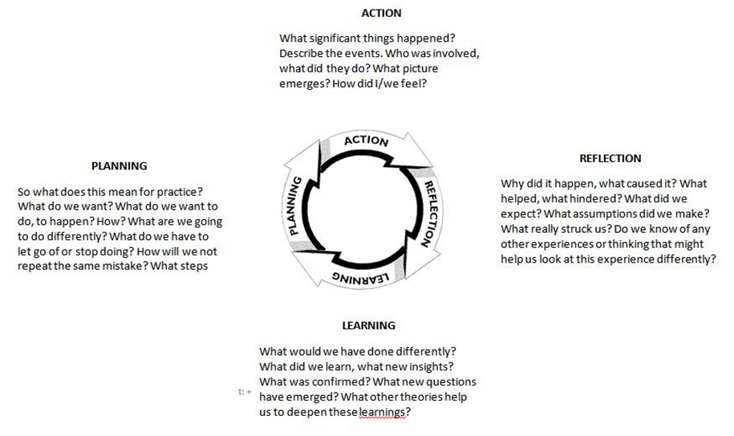
PME and the
ACTION LEARNING CYCLE
WHAT?
NOW WHAT?
SO WHAT?

Slide 21
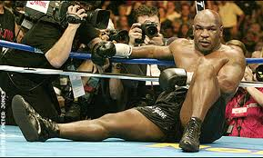
The Action Learning Cycle gets to the heart of adaptive management
Everyone has a plan …
until he gets hit!
Mike Tyson
Notes:
Michael Gerard "Mike" Tyson (also known as Malik Abdul Aziz) (born June 30, 1966) is a retired American professional boxer. Tyson is a former undisputed heavyweight champion of the world and holds the record as the youngest boxer to win the WBC, WBA and IBF heavyweight titles at 20 years, 4 months, and 22 days old. Tyson won his first 19 professional bouts by knockout, 12 of them in the first round. He won the WBC title in 1986 after defeating Trevor Berbick by a TKO in the second round. In 1987, Tyson added the WBA and IBF titles after defeating James Smith and Tony Tucker. He was the first heavyweight boxer to simultaneously hold the WBA, WBC and IBF titles, and the only heavyweight to successively unify them.

Slide 22
When do you monitor?
EXERCISE
When do we monitor?

Slide 23
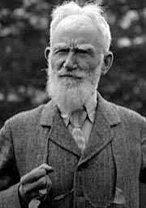
The only man who behaves sensibly is my tailor; he takes my measurements anew every time he sees me, while all the rest go on with their old measurements and expect me to fit them.
Monitoring must be an integral part of everything we do -Monitoring should be continuous.
George Bernard Shaw
Notes:
According to the strict dictionary definition monitoring is continuous and evaluation is periodic. The official project evaluations (mid-term and end of project reviews) will be external independent exercises. However, an effective and responsive monitoring system (an internal process) encourages evaluative thinking, i.e. reflective practice that incorporates the use of systematically collected data to inform action - so the distinction between monitoring and evaluation can be a little blurred in a multi-stakeholder project working in complexity e.g. The CPS Pollinators Project!!
Wikipedia entry: George Bernard Shaw (26 July 1856 – 2 November 1950) was an Irish playwright and a co-founder of the London School of Economics. Although his first profitable writing was music and literary criticism, in which capacity he wrote many highly articulate pieces of journalism, his main talent was for drama, and he wrote more than 60 plays. He was also an essayist, novelist and short story writer. Nearly all his writings address prevailing social problems, but have a vein of comedy which makes their stark themes more palatable. Issues which engaged Shaw's attention included education, marriage, religion, government, health care, and class privilege.

Slide 24
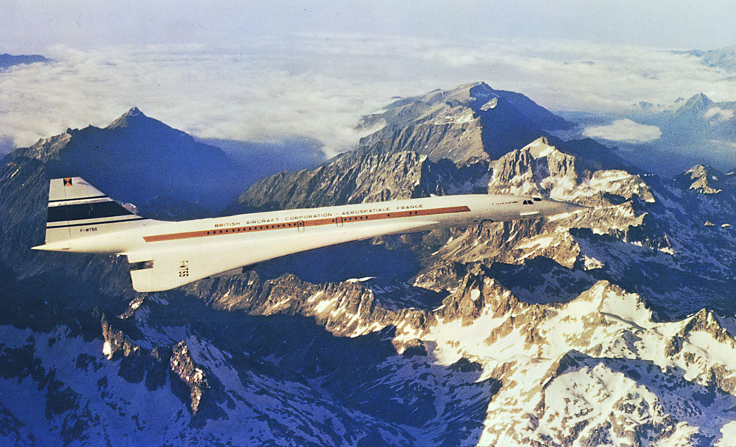
Concorde was constantly off course
But always reached its destination!
B
A
Notes:
The Perfectly Imperfect Concorde
Apparently, the jet goes too fast for human pilots to keep up with it. One wrong move and the Concorde is way off track. So back when it was still flying, the Concorde was flown by two computers that talk to each other. One autopilot would say something like “Hey! We’re off track! Get back on course!” And the other autopilot would say, “Recalculating. Getting back on track.”
Apparently, you could hear them talking to each other. They prattled on during the entire flight, yada yada yada—“Off track!” “Correcting course!” One guy on a tour of the Concorde asked why they were constantly talking to each other. Was the Concorde ever on course?
The tour guide said “Yes, about one percent of the time. The other ninety-nine percent of the time the jet veers off course, requiring constant autocorrection.” When asked what time the plane would arrive in New York by the concerned man, the tour guide said, “At 10 p.m., plus or minus three minutes.”

Slide 25
?
?
?
QUESTIONS?
on PME definitions,
uses & users,
Who is involved
Timing
?
?
?
?
?

Slide 26
What do we monitor?
EXERCISE
Brainstorm: What things do we monitor?

Slide 27
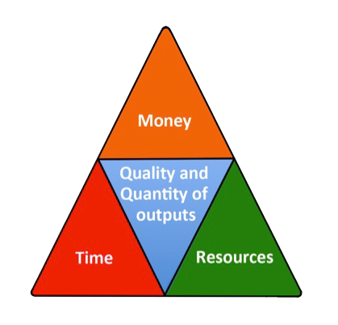
What do we monitor?
Inputs and Outputs

Slide 28
What do we monitor?
Activities

Slide 29
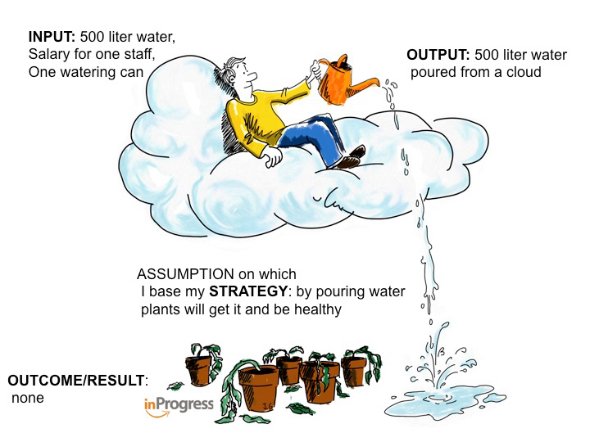
Monitoring inputs, outputs & activities alone is necessary but not sufficient

Slide 30
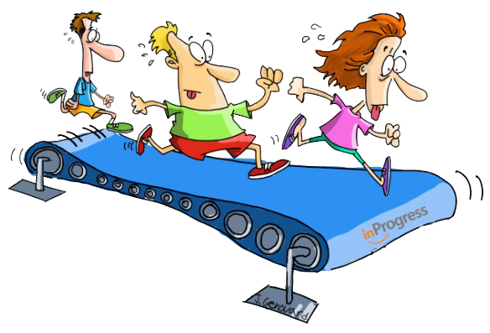
Monitoring inputs, outputs & activities can lead to
The doing without achieving syndrome

Slide 31
Monitoring what we do AND what we achieve (“results”)
Outcome: Changes in the behaviour, relationship, actions, policies or practices of social actors which can be plausibly linked to the activities and outputs of the project
Impact: Long-term, sustainable changes in the conditions of people and the state of the environment that structurally reduce poverty, improve human well-being and protect and conserve natural resources.

Slide 32
Why are outcomes defined in terms of behavioural change & not changes in state?
For each change in state (e.g. security of land for marginalised groups) there are always correlating changes in behaviour of certain people and groups.
Assessing changes in state does not necessarily provide the kind of information that projects need to improve their performance and relevance.
Development is done by and for people.

Slide 33

The challenge of planning, monitoring and evaluating for Outcomes and Impacts (what we achieve)

Slide 34
How do we get from inputs to impact?
Vision and
Mission
IMPACT
OUTCOMES
Are we efficient?
OUTPUTS
Are we effective?
ACTIVITIES
INPUTS
Plan
Time
Inspired by Jeff Conklin, cognexus.org

Slide 35
Conventional logic may work for outputs
Vision and
Mission
Workshops, training manuals, research and assessment reports, guidelines and action plans, strategies, and technical assistance packages, amongst others.
IMPACT
OUTCOMES
OUTPUTS
OUTPUTS
ACTIVITIES
ACTIVITIES
INPUTS
INPUTS
Plan
Time
Inspired by Jeff Conklin, cognexus.org
Inspired by Jeff Conklin, cognexus.org

Slide 36
But usually not for outcomes and impact
Vision and
Mission
Changes in the behaviour, relationship, actions, policies or practices of social actors and which can be plausibly linked to the activities and outputs of the network .
IMPACT
OUTCOMES
Long-term, sustainable changes in the conditions of people and the state of the environment that structurally reduce poverty, improve human well-being and protect and conserve natural resources.
OUTPUTS
ACTIVITIES
ACTIVITIES
INPUTS
INPUTS
Plan
Time
Inspired by Jeff Conklin, cognexus.org
Inspired by Jeff Conklin, cognexus.org
Notes:
This lack of control has been recognised by USAID: "In the development work that is the core of our programs, we almost never have total control over the results we seek to accomplish. Indeed, development results that would be within our control are not likely to represent sustainable development. Rather than limit ourselves to mundane, safe, but not useful results, our goal is to select objectives that reach high and inspire others but that are also within our manageable interests."

Slide 37
Why Outcomes and Impacts are so difficult to predict
An illustration of simplicity & complexity

Slide 38
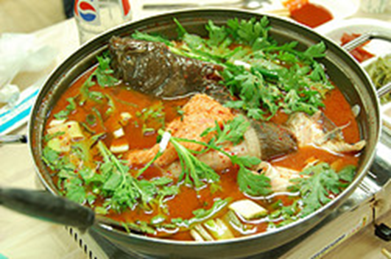
Inputs →Impact illustrated:
The fish soup development story
Courtesy of Ricardo Wilson-Grau
Inspired by Monika Jetzin, GWP Hungary

Slide 39
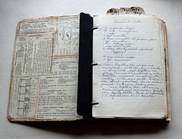

The fish soup development story
The parents follow the great grandmother’s recipe for fish soup.
The quantity and nature of the ingredients are spelled out, as well as the order in how they should be combined.
The parents do not need expertise although of course experience in cooking helps.
If they follow the recipe they will produce basically the same soup week after week.

Slide 40
Inputs or resources
  Parents get together fish, fresh vegetables, water, barley, spices, pot, source of heat
Activities
  Mother or father carefully prepare and cook all the ingredients
Output
  Children are given the most nourishing fish soup in the world
Outcome
  Children consider the soup delicious and eat fish soup once a week for the rest of their lives
Impact
  Children are healthy adults

Slide 41
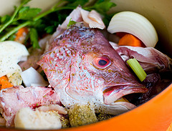
If only life were so simple!
In the real world, the results can be much less certain.
The great grandmother’s recipe is lost.
Her recommended fish is not available in the market every week of the year.
The family’s buying power varies from year to year.
Children are different and change as they grow:
  One becomes a vegetarian.
  Another goes on a diet.
  A third is simply rebellious.
Outside factors actors influence the children – school, TV, friends and so forth

Slide 42
Inputs or resources
  Parents get together fish, fresh vegetables, water, barley, spices, pot, source of heat
Activities
  Mother or father carefully prepare and cook all the ingredients
Parents control
Output
  Children are given the most nourishing fish soup in the world
Outcome
  Children consider the soup delicious and eat fish soup once a week for the rest of their lives
Parents influence
Impact
  Children are healthy adults
Parents worry

Slide 43
Circles of control, influence and
interest/concern/worry
indirect influence
Sphere of interest/concern
Grown up
Child 1
Grown up
Child 2
Grown up
Child 3
direct influence
Sphere of influence
Young child 2
Young child 1
Young child 3
direct control
Sphere of Control
Parents

Slide 44
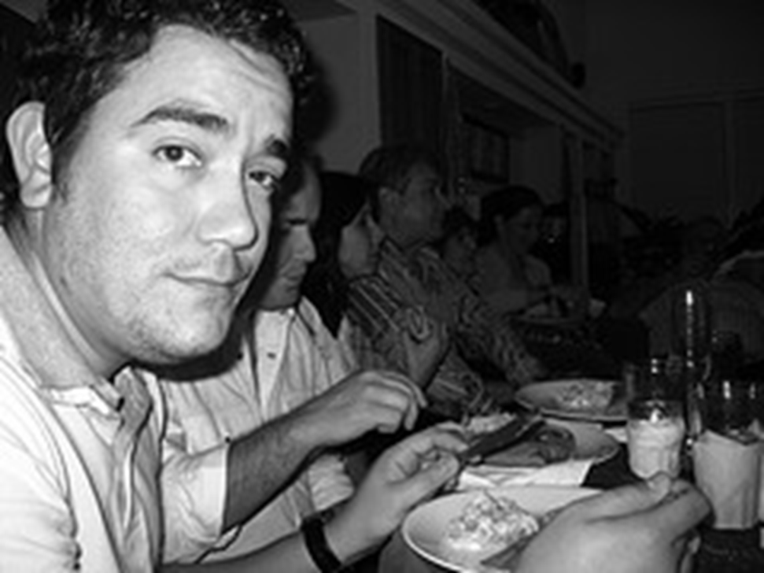
In such a complex situation
The relationships of cause and effect are unknown until the outcomes emerge.
To produce a nutritious soup that their children will eat once a week for the rest of their lives, the recipe is less important than the parents’ relationships with each son and daughter, and theirs with their social environment.
More than cooking experience
parent’s must rely on their
sensitivity and creativity.
And they must accept
uncertainty about the results.

Slide 45
The reality of multi-stakeholder cross-cutting projects is substantially complex
Vision and
Mission
IMPACT
The relationships of cause and effect are unknown
OUTCOMES
OUTPUTS
ACTIVITIES
INPUTS
Plan
Time
Inspired by Jeff Conklin, cognexus.org

Slide 46
In complex situations
Vision and
Mission
OUTCOME
OUTPUT
OUTCOME
OUTPUT
OUTCOME
OUTCOME
ACTIVITY
OUTPUT
OUTCOME
OUTPUT
ACTIVITY
OUTCOME
INPUTS
OUTCOME
ACTIVITY
OUTPUT
INPUTS
ACTIVITY
Plan
Time
INPUTS
INPUTS

Slide 47
Why don’t we measure impact?
EXERCISE
Brainstorm: Why do we not try to measure impact?

Slide 48
Impact Definitions
“Long-term, widespread improvement in society” – World Bank
“Longer term or ultimate result attributable to a development intervention” – OECD
“Long-term and national-level development change” – UNDP
“Ultimate sustainable changes, sometimes attributable to action. ” – Gates Foundation

Slide 49
Impact Definitions
“Long-term, widespread improvement in society” – World Bank
“Longer term or ultimate result attributable to a development intervention” – OECD
“Long-term and national-level development change” – UNDP
“Ultimate sustainable changes, sometimes attributable to action. ” – Gates Foundation

Slide 50
In summary
Programmes & projects operate in a complex and uncertain world
The logic of cause and effect can be effective in simple situations but is challenged by complexity
Impact is long term, attribution is often unrealistic and contribution to impact is often practically impossible to measure
  A programme more or less controls outputs
  Only influences outcomes
  And indirectly contributes to impact

Slide 51
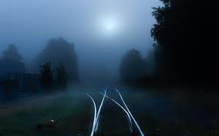
BUT we are still concerned with impact
Impact is our guiding star but not our measuring stick

Slide 52
Changing the M&E perspective
Old M&E:
M&E is mainly for external funding body
Concentrates on activities and financial reporting
Lots of data and little analysis (big reports!)
Little learning takes place
Little stakeholder participation
M&E is boring and not very useful for project staff and beneficiaries
New M&E
M&E is for everybody involved in project
Also look at effects and outcomes and why there is success and failure
Learning is a key function of M&E
Good analysis on how to improve project
Lots of stakeholder participation
M&E is active, interesting and useful

Slide 53
?
?
?
QUESTIONS?
on what we monitor
?
?
?
?
?

Slide 54
HOW DO WE MONITOR?
Assess readiness for monitoring
Establish tools for monitoring inputs, processes and outputs
Establish tools for monitoring results/outcomes

Slide 55
Assess readiness for monitoring
Why do we want to embark on setting up a monitoring system?
What are the advantages of setting up a monitoring system?
What are the difficulties people see in monitoring?
What are the necessary supporting measures?
Which incentives can be given to motivate people to monitor?
Who will be the responsible person(s) for designing and enforcing the monitoring system?
Who will be the users of the monitoring system?
What are the users’ needs? What type of information do the users need?
Whose interests and needs are to be given priority?

Slide 56
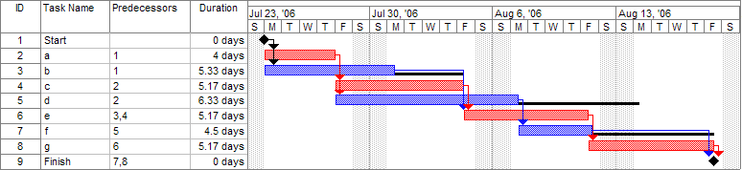
Tools for monitoring inputs, activities and outputs
a) Activities and tasks over time
Gantt charts = breakdown of tasks that must be completed in the required order to achieve a project result

Slide 57
Tools for monitoring inputs, activities and outputs
b) Money & resources
Original budget versus actual expenditures
Item | Budget | Expenditure | Variance/Comments
Staff costs specified by individual
Overhead costs
Travel & subsistence
Operating costs
Capital items/equipment
Others Consultancy
Others (please specify)
TOTAL
Continued…

Slide 58
Monitoring money & resources (continued)
What does the above table tell us?
The cost of the planned activity at completion.
If the planned and actual expenditure is on schedule or if there are any deviations.
If any variance is within a manageable margin of error.
If all the planned activities are being carried out as planned.
If there are sufficient financial resources to conduct activities.

Slide 59
Tools for monitoring inputs, activities and outputs
c) Quantity of outputs - Output tracking tools
Date Received | Citation | File name | Type of output | Status (draft, complete) | Follow up action | Notes
11 Jan 09 | EAFRINET brochure featuring the UVIMA Project (2009) | EAFRINET REVISED FLIER JAN 2009.pdf | Brochure | Complete
30 Jul 09 | The UVIMA Project Preparatory Workshop Summary Report. 29th June - 1st July 2009, Lukenya Getaway, Athi River, Kenya. | UVIMA Final Project Preparatory Workshop Report.pdf | Report | Complete
29 Sep 09 | Agwanda, B., Odhiambo, C. & Malaki, P. (2009). Baseline review of taxonomic capacity and infrastructure on pests in Kenya. | 2009-07_UVIMA_Kenya_Baseline_Pests.pdf | Report | Draft | JM to finalise editing & send to PK for formatting
Continued…

Slide 60
Tools for monitoring inputs, processes and outputs
d) Quality of outputs - Quality Assurance Checklists
 |  | To be completed by Author |  | To be completed by Reviewer
REQUIREMENT |  | AUTHOR X‑REFERENCE Page #/Section # | AUTHOR COMMENTS | COMPLY |  | REVIEWER COMMENTS
 |  |  |  | Y | N
1.0 GENERAL INFORMATION
1.1 | Purpose: Describes the purpose of the report
1.2 | Scope: Describes the scope of the report and how it relates to the project.
1.3 | Overview: Provides a brief overview description as a point of reference for the remainder of the report.
1.4 | References: Provides a list of the references that were used in preparation of the report.
1.5 | Acronyms and Abbreviations: Provide a list of the acronyms and abbreviations used in this report and the meaning of each.
1.6 | Points of Contact: Provides a list of points of organisational contact that may be needed by the document users for additional information and support.
Example Quality Assurance Checklist

Slide 61
?
?
?
QUESTIONS?
on tools for monitoring inputs, processes & outputs
?
?
?
?
?

Slide 62

Tools for Monitoring Outcomes
Outcome Mapping
Adapting the Project Logframe using Outcome Mapping
How can we adapt OM & the Project Logframe as part of the Project PME system?
A highly adaptable planning, monitoring and evaluation methodology

Slide 63
Origins of Outcome Mapping
Developed by the Evaluation Unit at the Canadian International Development Research Centre (IDRC)
IDRC grants annually over US$100 million to research organisations around the world. They developed Outcome Mapping between 1998 and 2000 because they required a different planning, monitoring and evaluation methodology.
Publication of the OM manual in 2000 (available in several languages including English & French).
Used in 100s of projects throughout the world
Used as a stand alone PME method or in combination with other methods, e.g. logframe.

Slide 64

Outcome Mapping Framework
INTENTIONAL DESIGN
Vision
Mission
Boundary Partners
Outcome Challenges
Progress markers
Strategy Maps
1. PLANNING (INTENTIONAL DESIGN)
What we are trying to accomplish and how?
How do we know we are on track?
Evaluation Plan
3. EVALUATION PLANNING
Monitoring Priorities
Monitoring Processes
2. OUTCOME &
PERFORMANCE MONITORING
What do we want to learn?

Slide 65
OM helps a project team
To be specific about the actors it targets, the changes it expects to see and the strategies it employs. =
WHO?
WHAT?
HOW?

Slide 66
The CPS Pollinators Project - Logframe
Project Goal
Project Sub-Goal
Monitoring of Results through
Sub-Goal indicators
What?
Project Purpose
Monitoring of Results through
Purpose indicators
WHO?
What?
Monitoring of
Project
Activities &
Output level
Indicators
Output
Output
Output
How?
Project activity
Project activity
Project activity
Who?
Project Management Team (Budget, HR, Organisational Practices)

Slide 67
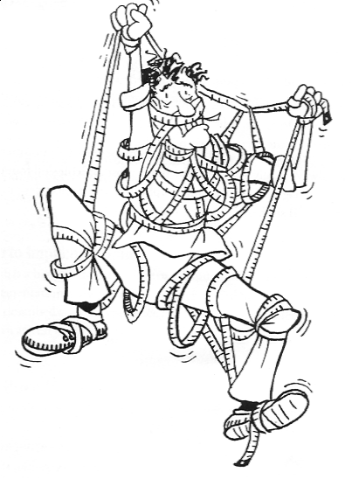
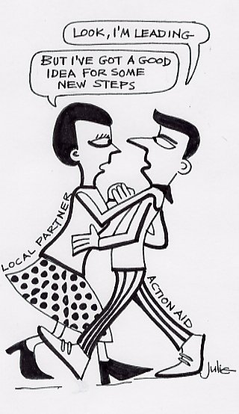
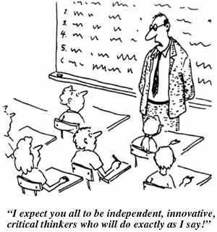
Inter-related challenges that stimulated the development of OM
Changes are complex and do not move in a linear way
A programme can influence outcomes but cannot control them
Development is done by and for people
Non-causality
Control of change
Contribution not attribution
Notes:
Three important principles in OM are:
1) Non-causality: Outcomes can be logically linked to a project’s activities but they are not necessarily directly caused by them.
3) Control of change / development: Outcome Mapping assumes that the boundary partners control change and that projects only facilitate the process by providing access to new resources, ideas, or opportunities for a certain period of time.
2) Contribution instead of attribution: When applying OM, a programme is not claiming the achievement of development impacts; rather, the focus is on its contributions to outcomes. The logic behind this is that long-term development goals are rarely accomplished by the work of a single actor and that the complexity of the development process makes it extremely difficult to actually assess impact.

Slide 68
Principles of use
Flexibility
  OM needs to be adapted to use in your specific context.
  It is not a fixed route but a guide for the journey we take.
Participatory
  OM implies dialogue and collaboration with partners.
  We co-create the ´map´ with our partners.
Evaluative thinking
  Fosters a reflective practice, organisational & social learning.

Slide 69
Attribution or Contribution?
How does your project make a difference?
program influence decreases
community capacity & ownership increases

Slide 70
The focus of Outcome Mapping
program influence decreases (is replaced)
changed behavior
community capacity & ownership increases

Slide 71
Brief definition of OM
A participatory method for planning, monitoring and evaluation;
Focuses on changes in behaviour of those with whom the project or program works; and
Oriented towards social change & organisational learning

Slide 72
Using OM to monitor the achievement of results
Define your vision (your dream) & mission (how you can contribute to the vision)
Define desired results/outcomes
  Identify & classify stakeholders
  Describe desired stakeholder outcomes
Define indicators (are we on track?)
Define our strategy (how do we contribute to an outcome?)
Prepare a monitoring plan

Slide 73

Step 1: Define your vision
Vision
improved human, social, & environmental wellbeing

Slide 74
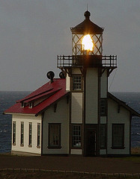
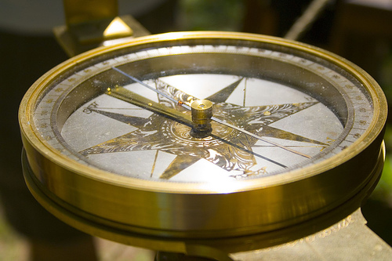

A Vision Statement..
guides
motivates and inspires
is an ‘accountability-free zone’
Notes:
Vision describes why the program is involved in development work
It is the beacon that guides day-to-day work
Probably won’t change for the life of the program
It articulates the values of the program
The vision goes beyond what the program alone can bring about but it will contribute
The program is never measured against its vision
It provides an inspirational focus for the program
It is the ideal that the program wants to bring about

Slide 75
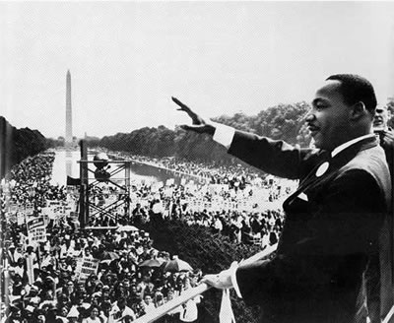
I have a set of objectively verifiable indicators!
Martin Luther King, Jr.
August 28, 1963
Notes:
MLK’s address to the largest civil rights demonstration in US history on the steps of the Lincoln Memorial in Washington DC - affected generations of social change
DID NOT say “I have a set of objectively verifiable indicators”
Described actions - what children, families, etc. would be doing differently if the USA were not a racially divided country
Dr. Martin Luther King Jr. had originally prepared a short and somewhat formal recitation of the sufferings of African Americans attempting to realize their freedom in a society chained by discrimination. He was about to sit down when gospel singer Mahalia Jackson called out, "Tell them about your dream, Martin! Tell them about the dream!" Encouraged by shouts from the audience, King drew upon some of his past talks, and the result became the landmark statement of civil rights in America -- a dream of all people, of all races and colors and backgrounds, sharing in an America marked by freedom and democracy. He said:
“…I have a dream that one day on the red hills of Georgia the sons of former slaves and the sons of former slave owners will be able to sit down together at the table of brotherhood.
I have a dream that one day even the state of Mississippi, a state sweltering with the heat of injustice.. [and] …oppression, will be transformed into an oasis of freedom and justice.
I have a dream that my four little children will one day live in a nation where they will not be judged by the color of their skin but by the content of their character…
I have a dream that one day down in Alabama… little black boys and black girls will be able to join hands with little white boys and white girls as sisters and brothers.”

Slide 76
I have a dream!
Martin Luther King, Jr.
August 28, 1963
Notes:
MLK’s address to the largest civil rights demonstration in US history on the steps of the Lincoln Memorial in Washington DC - affected generations of social change
DID NOT say “I have a set of objectively verifiable indicators”
Described actions - what children, families, etc. would be doing differently if the USA were not a racially divided country
Dr. Martin Luther King Jr. had originally prepared a short and somewhat formal recitation of the sufferings of African Americans attempting to realize their freedom in a society chained by discrimination. He was about to sit down when gospel singer Mahalia Jackson called out, "Tell them about your dream, Martin! Tell them about the dream!" Encouraged by shouts from the audience, King drew upon some of his past talks, and the result became the landmark statement of civil rights in America -- a dream of all people, of all races and colors and backgrounds, sharing in an America marked by freedom and democracy. He said:
“…I have a dream that one day on the red hills of Georgia the sons of former slaves and the sons of former slave owners will be able to sit down together at the table of brotherhood.
I have a dream that one day even the state of Mississippi, a state sweltering with the heat of injustice.. [and] …oppression, will be transformed into an oasis of freedom and justice.
I have a dream that my four little children will one day live in a nation where they will not be judged by the color of their skin but by the content of their character…
I have a dream that one day down in Alabama… little black boys and black girls will be able to join hands with little white boys and white girls as sisters and brothers.”

Slide 77
Vision Facilitation Questions
Imagine that, 5-10 years from now, the program has been extremely successful. Things have improved beyond your most ambitious dreams.
  What changes have occurred?
  What (& how) are your target communities (“beneficiaries”) doing?
  What are your partners doing?
  Describe the better world you are seeking.
(In essence: describe the world are you seeking to help create.)
Notes:
Be visionary and idealistic, but stay in reality – make it useful to you as a guide
Visions can be as long or as short as the program wants so long as people agree on that it represents the ideal they’re striving to help bring about.
Dream boldly !

Slide 78
CPS Vision Statement
The state and civil society in India will have an increased and shared understanding of the importance of conserving pollinators in Indian agricultural landscapes with a particular focus on supporting the small and marginal farming community engaged in ecologically prudent farming. This will ensure support for the sustainable delivery of pollination and other ecosystem services leading to improved, happy, hopeful and sustainable livelihoods.

Slide 79
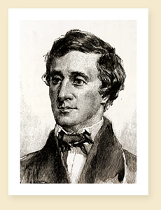
If you have built castles in the air, your work need not be lost; that is where they should be. Now put foundations under them.
Henry David Thoreau
Notes:
Wikipedia Entry: Henry David Thoreau (July 12, 1817 – May 6, 1862) was an American author, poet, philosopher, abolitionist, naturalist, tax resister, development critic, surveyor, historian, and leading transcendentalist. He is best known for his book Walden, a reflection upon simple living in natural surroundings, and his essay Civil Disobedience, an argument for individual resistance to civil government in moral opposition to an unjust state.

Slide 80

Step 2: Define your mission
The mission is that “bite” of the vision statement on which the program is going to focus.

Slide 81
A mission statement describes:
How the project intends to apply its resources in support of the vision
The areas in which the project intends to work
How the project will support the achievement of outcomes by its direct partners
Written in the future tense -
as something the project will do

Slide 82
Your mission is your “business”
What do you do?
Who are your principal collaborators?
How do you work with them?

Slide 83
Mission Facilitation Questions
  What areas do you need to work in?
  What do you need to do in these areas?
  Who can you work with?
  How will you stay effective, efficient, and relevant?
(In essence: How will the project contribute to the Vision.)
Notes:
Be visionary and idealistic, but stay in reality – make it useful to you as a guide
Visions can be as long or as short as the program wants so long as people agree on that it represents the ideal they’re striving to help bring about.
Dream boldly !

Slide 84
CPS Mission Statement
In support of the vision, the CPS will generate and share high quality, credible information about pollinators in Indian agro-ecosystems to increase the knowledge base for ecologically prudent farming. The CPS will collaborate with local people and agencies to encourage those working in pilot sites to adopt good farming practices to maintain healthy pollinator populations. The CPS will become financially and institutionally sustainable by developing collaborative initiatives; and intellectually vibrant by producing high impact factor publications. Quality research for the benefit of small and marginal farming communities will help to ensure bright futures for CPS researchers.

Slide 85

Summary
Vision
Mission
About the future
Idealistic
Not about the project
About the present & future
Feasible
About the project

Slide 86
?
?
?
QUESTIONS?
on Vision & Mission
?
?
?
?
?

Slide 87
Using OM to monitor the achievement of results
Define your vision (your dream) & mission (how you can contribute to the vision)
Define desired results/outcomes
  Identify & classify stakeholders
  Define desired stakeholder outcomes
Define indicators (are we on track?)
Define our strategy (how we contribute to an outcome)
Prepare a monitoring plan

Slide 88
Step 3: Identify & Classify Stakeholders
EXERCISE: Brainstorm
List all the people and groups of people who can be affected, positively or negatively, by the project

Slide 89
Stakeholder Circles: A programme can not control change, it can only influence and contribute to changes at the level of its direct partners
indirect influence
Sphere of interest/concern
Community1
Community 2
Community 3
direct influence
Sphere of influence
Direct partner 2
Direct partner 1
Direct partner 3
direct control
Sphere of Control
Implementing team
Notes:
Explain the use of the word “community” instead of “beneficiary”

Slide 90
The Serenity Prayer
God, grant me the serenity to accept the things I cannot change,
The courage to change the things I can,
And the wisdom to know the difference.

Slide 91
Those within your sphere of influence are your “Boundary Partners”
Who do you aim to inspire, persuade, support or encourage?
Those individuals, groups, and organizations – from civil society, government or business – with whom you:
Interact directly to effect change
Anticipate opportunities for change
Ideally, engage in mutual learning

Slide 92
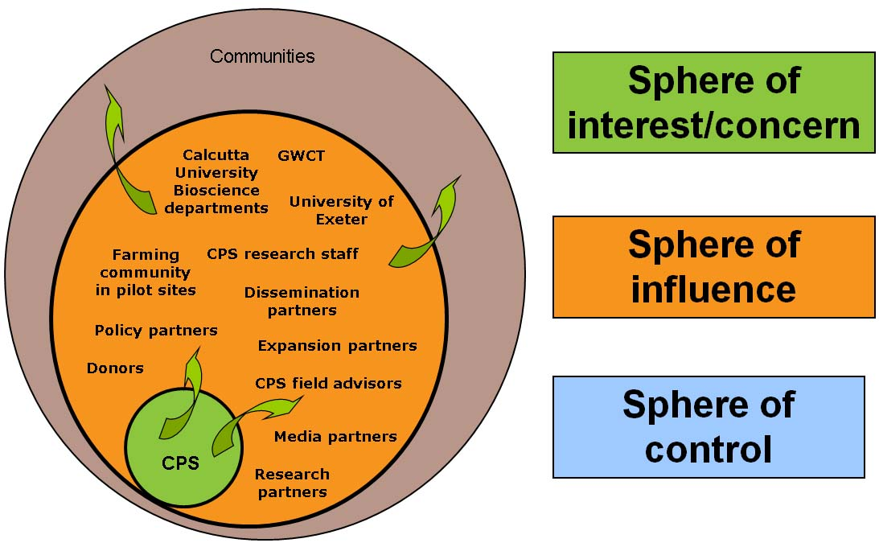
CPS Boundary Partners

Slide 93
Boundary Partners have Boundary Partners
Project
Project’s BPs
BP’s BPs

Slide 94
?
?
?
QUESTIONS?
on Boundary Partners & Stakeholders
?
?
?
?
?

Slide 95
Step 4: Define desired stakeholder outcomes
Can your Boundary Partners behave in new ways which support the project’s Mission & contribute to its Vision?
How would your Boundary Partners behave if the project was extremely successful?
These stakeholder outcomes are known as Outcome Challenges.

Slide 96
Outcome Challenge characteristics
One for each boundary partner
Describes the boundary partners’ ideal (but possible) contribution to the vision
Written like this: “The project intends to see [Boundary Partner] who [description of behaviours in the active present tense]”

Slide 97
Outcome Challenge Facilitation Questions
Ideally, in order to contribute to the Vision, how would the Boundary Partner be behaving?
With whom would they be interacting?
What would they be doing to contribute maximally to the vision?

Slide 98
Example Outcome Challenge statement: Research Partners
The CPS intends to see research partners who are:
Collaborating with CPS in developing and implementing new research projects; and
Jointly organising national/international symposia/training with CPS.

Slide 99
?
?
?
QUESTIONS?
on Outcome Challenges
?
?
?
?
?

Slide 100
Using OM to monitor the achievement of results
Define your vision (your dream) & mission (how you can contribute to the vision)
Define desired results/outcomes
  Identify & classify stakeholders
  Define desired stakeholder outcomes
Define indicators (are we on track?)
Define our strategy (how we contribute to an outcome)
Prepare a monitoring plan

Slide 101
Step 5: Define Progress markers (“Progress Indicators”)
Describe changes in actions, activities and relationships leading to the ideal outcome
Articulate the complexity of the change process
Can be monitored & observed
Enable on-going assessment of partner’s progress (including unintended results)

Slide 102
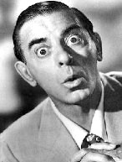
Change is a process not an event
It took me 20 years to become an overnight success!
Change is a process not an event
Progress markers help us to break down the change & process and adapt our strategy to it
Progress markers are like mini Outcome Challenges
Eddie Cantor
Notes:
Wikipedia entry: Eddie Cantor (January 31, 1892 – October 10, 1964), born Edward Israel Iskowitz, was an American "illustrated song" performer, comedian, dancer, singer, actor and songwriter. Familiar to Broadway, radio, movie and early television audiences, this "Apostle of Pep" was regarded almost as a family member by millions because his top-rated radio shows revealed intimate stories and amusing anecdotes about his wife Ida and five daughters. Some of his hits include "Makin' Whoopee," "Ida," "If You Knew Susie," "Ma! He's Makin' Eyes at Me," "Margie" and "How Ya Gonna Keep 'Em Down on the Farm (After They've Seen Paree?)" He also wrote a few songs, including "Merrily We Roll Along," the Merrie Melodies Warner Bros. cartoon theme.

Slide 103

The Outcome Challenge alone is not sufficient
We need indicators (“markers”)
to help us to assess whether we are on track?

Slide 104
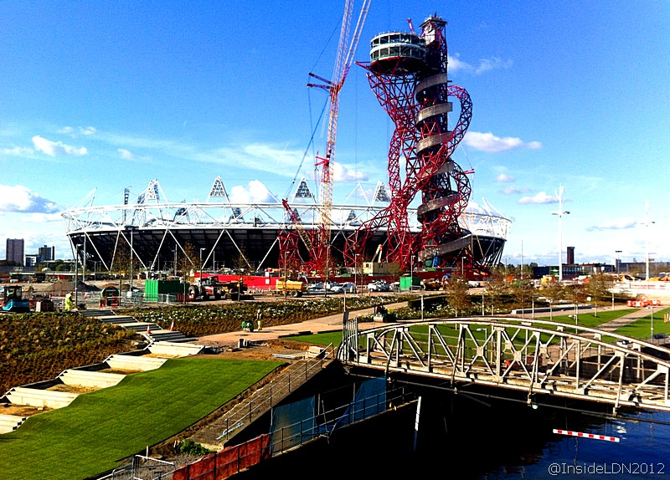
Journey to the Olympics

Slide 105
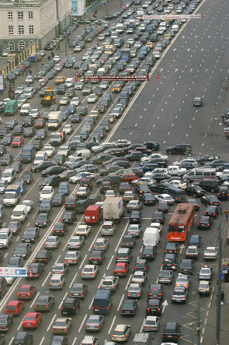
Change is usually gradual
“You cannot change your systems overnight and you cannot change them all at once. A country can change the side of the road it drives on overnight, but not without huge education programmes, changes in signposts and traffic systems and accepting the inevitability of a certain number of accidents.” Barefoot Guide 2: Learning practices in organisations and social change

Slide 106
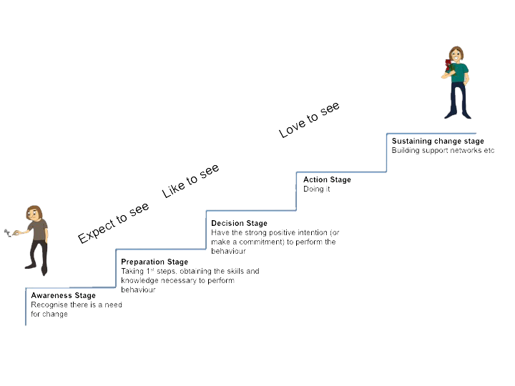
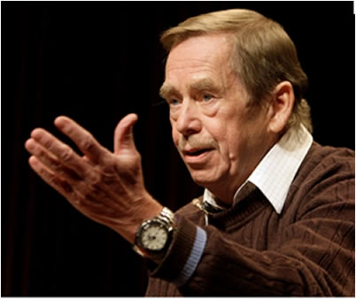
Vision is not enough; it must be combined with venture. It is not enough to stare up to the step; we must step up the stairs…
Va'clav Havel
Notes:
Wikipeida entry: Václav Havel; 5 October 1936 – 18 December 2011) was a Czech playwright, essayist, poet, dissident and politician.
Havel was the ninth and last president of Czechoslovakia (1989–1992) and the first president of the Czech Republic (1993–2003). He wrote more than 20 plays and numerous non-fiction works, translated internationally.
Havel was voted 4th in Prospect magazine's 2005 global poll of the world's top 100 intellectuals.At the time of his death he was Chairman of the New York-based Human Rights Foundation.

Slide 107

Progress Markers (ladders of change)
Love to see
Expanding influence, helping others, sharing expertise
Like to see
Actively engaged, learning, commitment
Expect to see
Early encouraging response to project, initial engagement

Slide 108
Example Progress Markers:
Research Partners
The CPS intends to see research partners who are:
Collaborating with CPS in developing and implementing new research projects; and
Jointly organising national/international symposia/training with CPS.
CPS Expects to See Research Partners:
Willing to meet with CPS and discuss the development and implementation of joint research projects.
CPS would Like to See Research Partners:
Developing research projects with CPS.
Sharing their insights with CPS in a transparent way.
Jointly organising trainings with CPS.
CPS would Love to See Research Partners:
Approaching CPS for advice and collaboration.
Implementing funded research projects with CPS.

Slide 109
?
?
?
QUESTIONS?
on Progress Markers
?
?
?
?
?

Slide 110
Using OM to monitor the achievement of results
Define your vision (your dream) & mission (how you can contribute to the vision)
Define desired results/outcomes
  Identify & classify stakeholders
  Define desired stakeholder outcomes
Define indicators (are we on track?)
Define our strategy (how we contribute to an outcome)
Prepare a monitoring plan

Slide 111
Define our Strategy – The Strategy Map
Define our strategy (how we contribute to an outcome), the activity mix
Targeted directly at the BP (individuals, teams, organisations), or
Targeted at the environment in which the BP is working
Project interventions are likely to change during an initiative
Adaptive Management

Slide 112
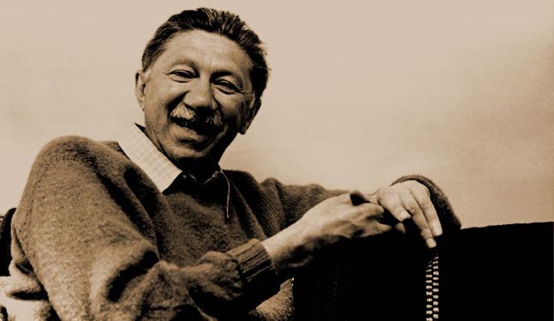
Remember to use a variety of approaches
If the only tool you have is a hammer, you tend to see every problem as a nail
Abraham Maslow
Notes:
Wikipedia entry: Abraham Harold Maslow (April 1, 1908 – June 8, 1970) was an American psychologist who was best known for creating Maslow's hierarchy of needs, a theory of self-actualization. Maslow was a psychology professor at Brandeis University, Brooklyn College, New School for Social Research and Columbia University. He stressed the importance of focusing on the positive qualities in people, as opposed to treating them as a "bag of symptoms."

Slide 113









6 interlinked kinds of strategies
 | causal | persuasive | supportive
I aimed at individual boundary partner
E aimed at boundary partner’s environment

Slide 114
6 interlinked kinds of strategies
 | causal | persuasive | supportive
I aimed at individual boundary partner | strong influence | arouse new thinking; build skills, capacity | on-going support
E aimed at boundary partner’s environment | alter the physical, regulatory or information environment | broad information dissemination; access to new info | create / strengthen peer networks

Slide 115
Facilitation Questions
causal
persuasive
supportive
How will sustained support, guidance or mentoring be provided?
What will be done to produce immediate outputs?
I
aimed at individual boundary partner
What will be done to build capacity?
E
aimed at boundary partner’s environment
What networks or relationships will be established or utilized?
What will be done to alter the physical or policy environment?
How will the media or publications be used?

Slide 116
Using OM to monitor the achievement of results
Define your vision (your dream) & mission (how you can contribute to the vision)
Define desired results/outcomes
  Identify & classify stakeholders
  Define desired stakeholder outcomes
Define indicators (are we on track?)
Define our strategy (how we contribute to an outcome)
Prepare a monitoring plan

Slide 117
The CPS Pollinators Project - Logframe
Project Goal
Project Sub-Goal
Monitoring of Results through
Sub-Goal indicators
What?
Project Purpose
Monitoring of Results through
Purpose indicators
WHO?
What?
Monitoring of
Project
Activities &
Output level
Indicators
Output
Output
Output
How?
Project activity
Project activity
Project activity
Who?
Project Management Team (Budget, HR, Organisational Practices)

Slide 118
The CPS Pollinators Project – Adapted Logframe
Project Goal
Vision
Project Sub-Goal
Monitoring of Results through
Sub-Goal indicators
What?
Project Purpose
Monitoring of Results through
Purpose indicators
Boundary
Partner A
Boundary
Partner B
Boundary
Partner C
Who?
Outcome Challenge
Outcome Challenge
Monitoring of
Boundary Partner
Outcomes through
Progress Markers
Outcome Challenge
What?
Progress
Markers
Progress
Markers
Progress
Markers
What?
Monitoring of
Project
Activities &
Output level
Indicators
Output
Output
Output
How?
Project activity
Project activity
Project activity
Who?
Project Management Team (Budget, HR, Organisational Practices)
Mission

Slide 119
?
?
?
QUESTIONS?
on Strategy Maps
?
?
?
?
?

Slide 120
DEVELOPING A PME SYSTEM FOR THE CPS POLLINATORS PROJECT - MONITORING

Slide 121
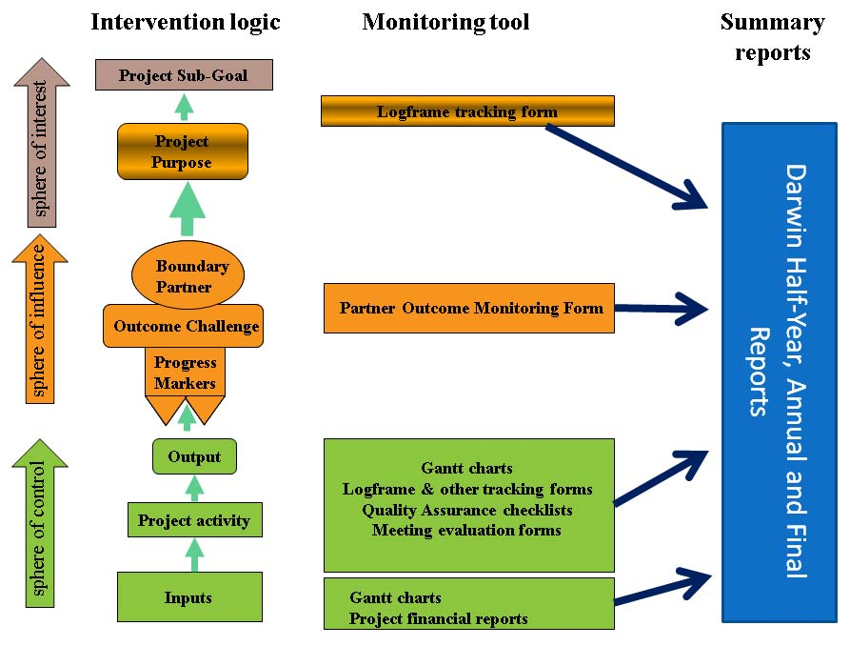

Slide 122
Monitoring tools
Objective level indicators – develop “stories of change” from documented outcomes.
Boundary Partner achievements (Outcome Challenges and Progress Markers) – develop data collecting processes to capture what happened (who did what, where and when), degree of success, limiting factors, lessons learned, etc.
Project activities & output indicators – activity journal incorporating an output tracking tool.
Project inputs (money & resources) – standard Darwin templates.

Slide 123
Monitoring Journal
The backbone of the system
Who did what, where, when, with whom, why it was important, what next and sources of further information
  "CODE" - unique identifier code for each CPS team member
  "WHO" (BP)Which Boundary Partner(s) was involved"
  "WHO" (OTHERS)Which other social actors(s) was involved"
  WHERE" Location of the event / activity / task"
  "SIGNIFICANCE" How does the event contribute to specific activities, outcomes or objectives(optional)"
  "CATEGORY" - field visit, data analysis, report completion, meeting, etc.
  "NOTES" Further relevant information including details of social actors involved where the ""multiple"" option is selected for columns D-F"
  "FOLLOW-UP ACTIONS" Who will do what, when, where and with whom to follow up on this event"
  "LINKS" To supporting documents, URLs, etc.

Slide 124
John’s Daily Log
Day | Date | Category | Notes
Sun | 09 Jan 2011 | BioNET | Evaluation: discussion with RS re. classification of LOOP Outcomes
Sun | 09 Jan 2011 | BioNET | Edited LOOP outcomes & sent to KR & RS for comment
Sun | 09 Jan 2011 | Football | FA Cup Round : Man U 1 Liverpool 0; Chelsea 7 Ipswich 0
Sun | 09 Jan 2011 | Film | The blind side with Sandra Bullock: True story of Michael Orr
Mon | 10 Jan 2011 | WAFRINET | Finalised and emailed feedback to Muaka Toko re. JRS proposal
Mon | 10 Jan 2011 | BioNET | Looked through LOOP Outcomes & sorted into one sheet per LOOP
Mon | 10 Jan 2011 | Quote | “The greatest way to live with honour in this world is to be what you pretend to be.” – Socrates
Mon | 10 Jan 2011 | Home | Phoned Maureen to check on Uncle Kevin’s condition

Slide 125
?
?
?
QUESTIONS?
on Monitoring Tools
?
?
?
?
?

Slide 126
5 things to remember about PME…
Understanding is more valuable to donors than attribution.
There is power in systematically collected and used monitoring data.
People don’t always know what they want until they see it.
Changed relationships may be more significant than changes in state.
There is no ‘end destination’, change keeps on going.

Slide 127

Embrace Complexity
Look at the bigger picture
See yourself as a part of an interconnected web of relationships and systems

Slide 128

Change is constant
“It’s not possible to see the same river twice” Heraclitus

Slide 129

Recognise that change is…
Continuous
Complex
Non-linear
Not controllable
Multidirectional

Slide 130

Keep your eyes wide open…
Being attentive along the journey is as important as the destination

Slide 131
Acknowledgments
This presentation makes use of various materials that were shared by OM community members on the OM learning community website http://www.outcomemapping.ca/. Without being exhaustive special thanks goes to Terry Smutylo, Simon Hearn, Sonia Herrero, Jan Van Ongevalle, Daniel Roduner and Ricardo Wilson-Grau.

Slide 132
References
The Barefoot Guide, by the Barefoot community of practice, www.barefootguide.org
inProgress (2012). Integrated Monitoring: a Practical Manual for Organisations That Want to Achieve Results. http://www.inprogressweb.com/resource-library/monitoring-evaluation/
Earl, S., Carden, F. & Smutylo, T. (2001). Outcome mapping: Building learning and reflection into development programs. Ottawa: International Development Research Centre. http://www.outcomemapping.ca/resource/resource.php?id=269

