Slide 1
Project Benefit Monitoring & Evaluation System
For the Cameroon Biosecurity Project
John Mauremootoo
Prudence Galega

Slide 2
Biosecurity: Definition
Biosecurity is a strategic and integrated approach that encompasses the policy and regulatory frameworks (including instruments and activities) that analyse and manage risks in the sectors of food safety, animal life and health, and plant life and health, including associated environmental risk. Biosecurity covers the introduction of plant pests, animal pests and diseases, and zoonoses, the introduction and release of genetically modified organisms (GMOs) and their products, and the introduction and management of invasive alien species and genotypes.

Slide 3
In other words …
The protection of biodiversity from all biological threats from all pathways into and within a country.

Slide 4
Cameroon Biosecurity Project Objective
to increase capacity to prevent and control the introduction, establishment and spread of Invasive Alien Species (IAS) and management of LMOs in Cameroon through the implementation of a risk-based decision making process

Slide 5

Biosecurity
David Cook, ‘Without biosecurity, higher crop yields mean better-fed rodents’, The Conversation, 12 April 2011.
Notes:
Dr David Cook is a Research Scientist with CSIRO Entomology's Invasion Risk Ecology team. He currently manages the Enhanced Risk Analysis Tools project within the Cooperative Research Centre (CRC) for National Plant Biosecurity's Preparedness programme. His research is aimed at protecting Australia from incursions of exotic pest species through risk identification and assessment.

Slide 6
Objective
To outline the Project Benefit Monitoring and Evaluation (PBME) System for the Cameroon Biosecurity Project

Slide 7
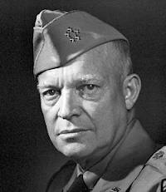
plans are useless but planning is indispensable.
Dwight D. Eisenhower
Notes:
Wikipedia entry: Dwight David "Ike" Eisenhower (October 14, 1890 – March 28, 1969) was the 34th President of the United States from 1953 until 1961. He had previously been a five-star general in the United States Army during World War II, and served as Supreme Commander of the Allied Forces in Europe; he had responsibility for planning and supervising the invasion of North Africa in Operation Torch in 1942–43 and the successful invasion of France and Germany in 1944–45, from the Western Front. In 1951, he became the first supreme commander of NATO.

Slide 8
Structure of the presentation
Introduction:
    What PME is
    Why a PME system is needed
    Who needs a PME system
    Who is involved in PME
    When we monitor and evaluate
    What we monitor and evaluate
    How we monitor and evaluate
The PBME System for the Cameroon Biosecurity Project:
    Monitoring inputs
    Monitoring activities & outputs
    Monitoring outcomes
    Monitoring objectives
    Implementation of the system

Slide 9
The elements of the process
Planning discussions between consultants and the PCU
Project partner workshop to develop the elements of a PBME system
PCU together with the international & national consultants develops a detailed draft PBME system
The draft system is finalised by an iterative and interactive process following the project partner workshop
The system is used, reviewed and updated as necessary by the PCU and project partners with technical input from the consultants

Slide 10
Objectives of this Workshop
To reach a common understanding of the rationale for the development of the PBME system
To develop the elements of a PBME system that will be highly participatory and encourage ownership of project-related outcomes in order to maximise chances of long-term impact and sustainability.

Slide 11
Exercise: What is M&E?
EXERCISE
Draw a picture of what monitoring and evaluation represents for you
Notes:
Examples used: Face with large ears and eyes but only a small mouth
Shadow that accompanies you at all times
Spiders web with monitoring always connecting you to the goals which are at the core of everything you do

Slide 12
What is M&E?
Monitoring is the ongoing, systematic collection of data to provide management and the main stakeholders of an intervention with indications of the extent of progress and achievement of objectives and progress in the use of allocated funds.
Evaluation is a periodic systematic data-based assessment to provide useful feedback about an intervention (programme policy, project, etc.) for its intended users. The intervention is evaluated on stated criteria, e.g. relevance, efficiency, effectiveness, sustainability and impact.
Notes:
Emphasise the fact that in multi-stakeholder projects operating in complexity there is considerable overlap between planning, monitoring and evaluation.

Slide 13

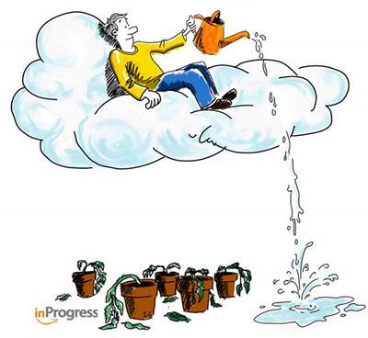
Why monitor?
EXERCISE
What does this picture illustrate about monitoring?
What can be done to improve this situation?

Slide 14
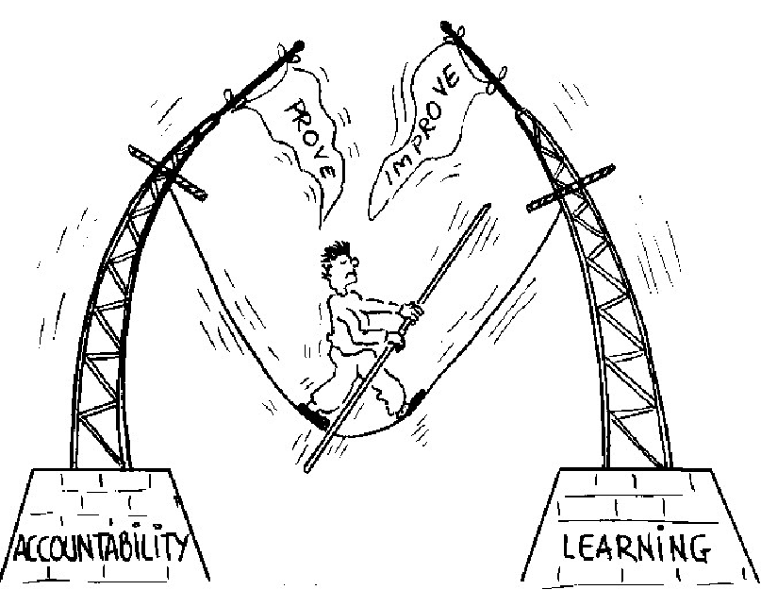
Accountability & Learning
Notes:
Upward and downward accountability and the tension between the two

Slide 15
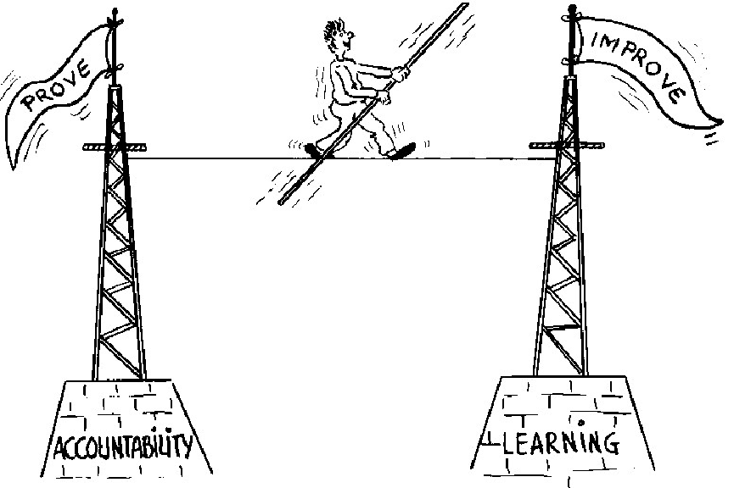
The M&E Balancing Act

Slide 16
Begin with the end in mind
EXERCISE
Brainstorm: What will be the legacy of the Cameroon Biosecurity Project?

Slide 17
For whom do we monitor? USERS
EXERCISE
Brainstorm: Who do we monitor for? =USERS

Slide 18
Who is involved in monitoring & how does it work?
EXERCISE
A project has just organised a training course with a local community. The facilitators compiled information about the course – cost, number of participants, number of manuals and the results of the course evaluation. Most participants stated that the training was informative but that they did not know how to use the knowledge in their daily work.
The cards you have been given represent states of the monitoring process.
Organise the cards into a logical monitoring time sequence. Explain your results
The Cameroon Biosecurity Project

Slide 19






Who is involved in monitoring?
Field staff
Community
Project Implementation Team
Management Team of Project Implementing Organisation
Donors
Notes:
1= Field Staff; 2 = Community; 3 = Project Implementation Team; 4 = Management Team of Project Implementing Organisation; 5 = Donors

Slide 20
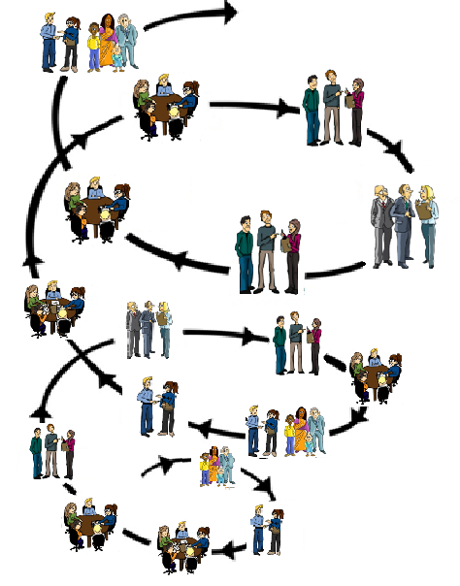
Action → Reflection → Learning → Planning
Putting the P in PME
Notes:
Michael Quinn Patton, Developmental evaluation p134 - "A primary strategy for coping with uncertainty applies to both programmes and evaluations and the interactions between the two: shorten and speed up feedback. The longer the time horizon the greater the uncertainty. Long term outcomes and impacts are especially uncertain.“

Slide 21
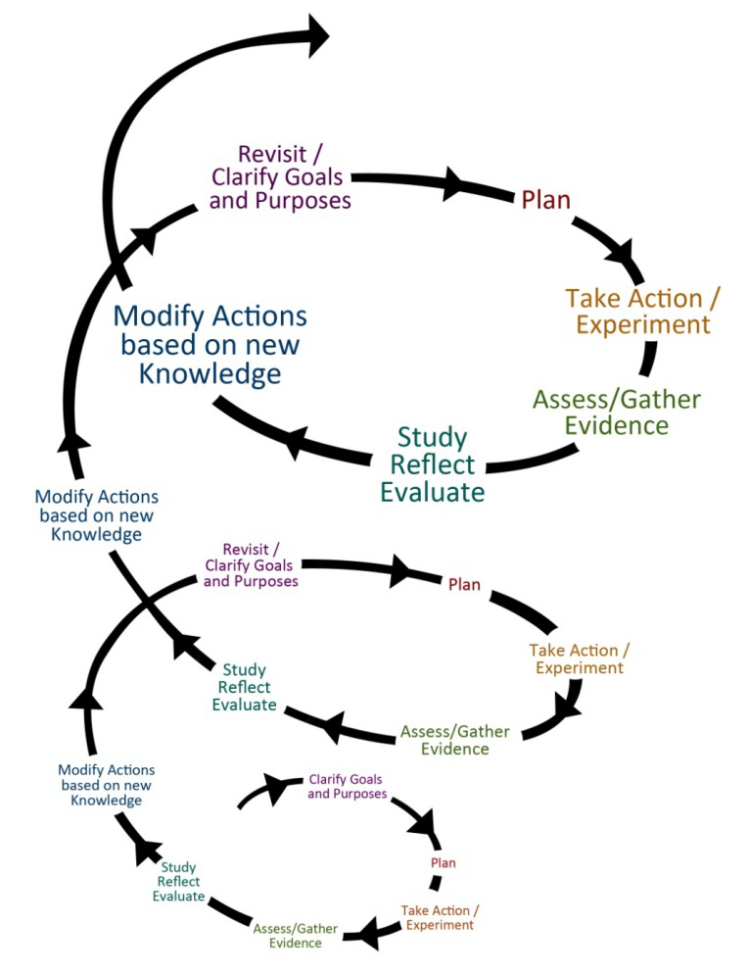
Action → Reflection → Learning → Planning
Putting the P in PME

Slide 22
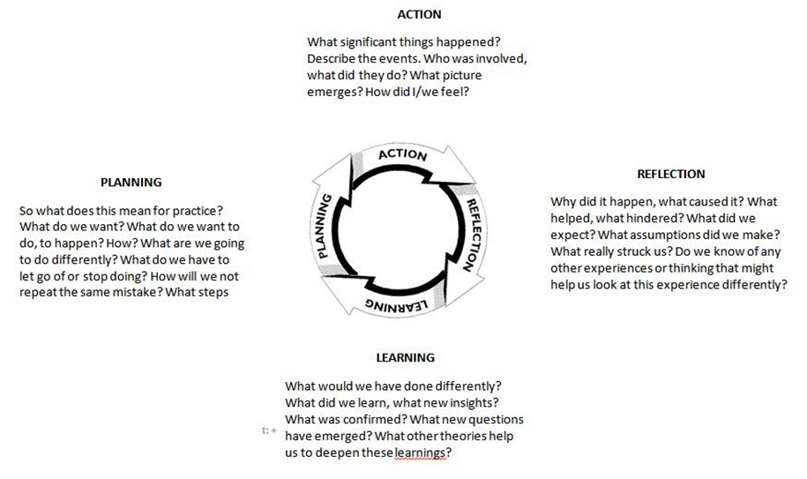
PME and the
ACTION LEARNING CYCLE
WHAT?
NOW WHAT?
SO WHAT?

Slide 23
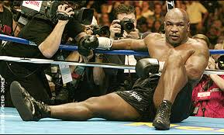
The Action Learning Cycle gets to the heart of adaptive management
Everyone has a plan …
until he gets hit!
Mike Tyson
Notes:
Michael Gerard "Mike" Tyson (also known as Malik Abdul Aziz) (born June 30, 1966) is a retired American professional boxer. Tyson is a former undisputed heavyweight champion of the world and holds the record as the youngest boxer to win the WBC, WBA and IBF heavyweight titles at 20 years, 4 months, and 22 days old. Tyson won his first 19 professional bouts by knockout, 12 of them in the first round. He won the WBC title in 1986 after defeating Trevor Berbick by a TKO in the second round. In 1987, Tyson added the WBA and IBF titles after defeating James Smith and Tony Tucker. He was the first heavyweight boxer to simultaneously hold the WBA, WBC and IBF titles, and the only heavyweight to successively unify them.

Slide 24
When do you monitor?
EXERCISE
When do we monitor?

Slide 25
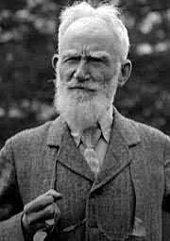
The only man who behaves sensibly is my tailor; he takes my measurements anew every time he sees me, while all the rest go on with their old measurements and expect me to fit them.
Monitoring must be an integral part of everything we do -Monitoring should be continuous.
George Bernard Shaw
Notes:
According to the strict dictionary definition monitoring is continuous and evaluation is periodic. The official project evaluations (mid-term and end of project reviews) will be external independent exercises. However, an effective and responsive monitoring system (an internal process) encourages evaluative thinking, i.e. reflective practice that incorporates the use of systematically collected data to inform action - so the distinction between monitoring and evaluation can be a little blurred in a multi-stakeholder project working in complexity e.g. the Cameroon Biosecurity Project!!
Wikipedia entry: George Bernard Shaw (26 July 1856 – 2 November 1950) was an Irish playwright and a co-founder of the London School of Economics. Although his first profitable writing was music and literary criticism, in which capacity he wrote many highly articulate pieces of journalism, his main talent was for drama, and he wrote more than 60 plays. He was also an essayist, novelist and short story writer. Nearly all his writings address prevailing social problems, but have a vein of comedy which makes their stark themes more palatable. Issues which engaged Shaw's attention included education, marriage, religion, government, health care, and class privilege.

Slide 26
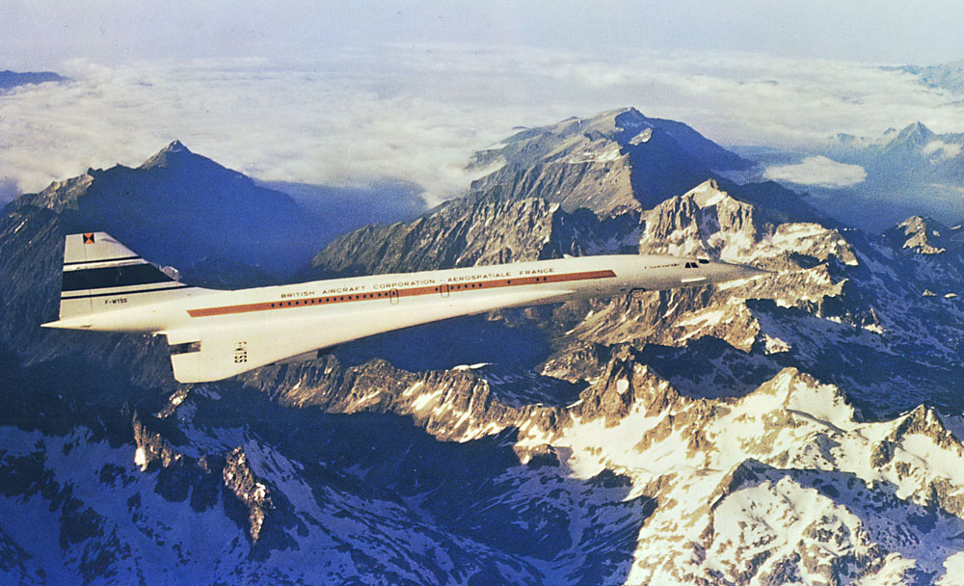
Concorde was constantly off course
But always reached its destination!
B
A
Notes:
The Perfectly Imperfect Concorde
Apparently, the jet goes too fast for human pilots to keep up with it. One wrong move and the Concorde is way off track. So back when it was still flying, the Concorde was flown by two computers that talk to each other. One autopilot would say something like “Hey! We’re off track! Get back on course!” And the other autopilot would say, “Recalculating. Getting back on track.”
Apparently, you could hear them talking to each other. They prattled on during the entire flight, yada yada yada—“Off track!” “Correcting course!” One guy on a tour of the Concorde asked why they were constantly talking to each other. Was the Concorde ever on course?
The tour guide said “Yes, about one percent of the time. The other ninety-nine percent of the time the jet veers off course, requiring constant autocorrection.” When asked what time the plane would arrive in New York by the concerned man, the tour guide said, “At 10 p.m., plus or minus three minutes.”

Slide 27
What do we monitor?
EXERCISE
Brainstorm: What do we monitor?

Slide 28
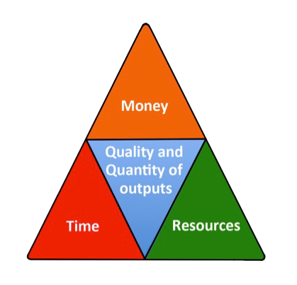
What do we monitor?
Inputs and Outputs

Slide 29
What do we monitor?
Activities

Slide 30
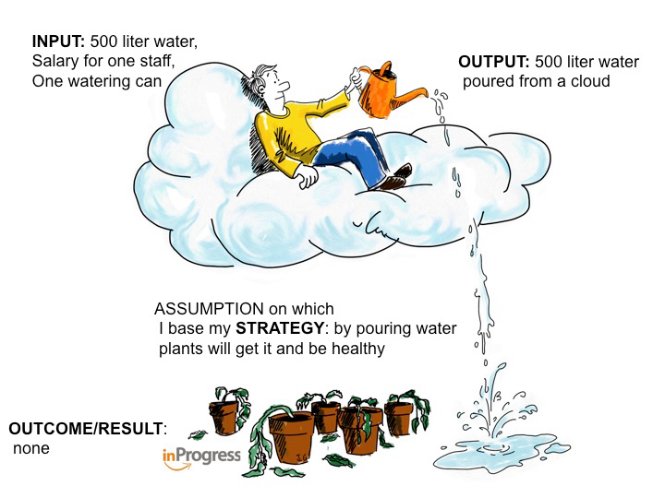
Monitoring inputs, outputs & activities alone is necessary but not sufficient

Slide 31
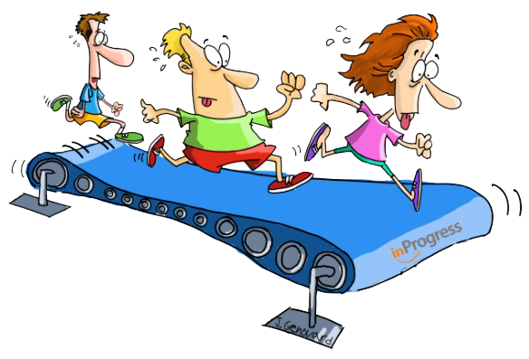
Monitoring inputs, outputs & activities can lead to
The doing without achieving syndrome
Running on a Treadmill

Slide 32
Monitoring what we do AND what we achieve (“results”)
Outcome: Changes in the behaviour, relationship, actions, policies or practices of social actors and which can be plausibly linked to the activities and outputs of the project
Impact: Long-term, sustainable changes in the conditions of people and the state of the environment that structurally reduce poverty, improve human well-being and protect and conserve natural resources.

Slide 33
Why are outcomes defined in terms of behavioural change & not changes in state?
For each change in state (e.g. security of land for marginalised groups) there are always correlating changes in behaviour of certain people and groups.
Assessing changes in state does not necessarily provide the kind of information that projects need to improve their performance and relevance.
Development is done by and for people.

Slide 34

The challenge of planning, monitoring and evaluating for Outcomes and Impacts (what we achieve)

Slide 35
How do we get from inputs to impact?
Vision and
Mission
IMPACT
OUTCOMES
Are we efficient?
OUTPUTS
Are we effective?
ACTIVITIES
INPUTS
Plan
Time
Inspired by Jeff Conklin, cognexus.org

Slide 36
Conventional logic may work for outputs
Vision and
Mission
Workshops, training manuals, research and assessment reports, guidelines and action plans, strategies, and technical assistance packages, amongst others.
IMPACT
OUTCOMES
OUTPUTS
OUTPUTS
ACTIVITIES
ACTIVITIES
INPUTS
INPUTS
Plan
Time
Inspired by Jeff Conklin, cognexus.org
Inspired by Jeff Conklin, cognexus.org

Slide 37
But usually not for outcomes and impact
Vision and
Mission
Changes in the behaviour, relationship, actions, policies or practices of social actors and which can be plausibly linked to the activities and outputs of the network .
IMPACT
OUTCOMES
Long-term, sustainable changes in the conditions of people and the state of the environment that structurally reduce poverty, improve human well-being and protect and conserve natural resources.
OUTPUTS
ACTIVITIES
ACTIVITIES
INPUTS
INPUTS
Plan
Time
Inspired by Jeff Conklin, cognexus.org
Inspired by Jeff Conklin, cognexus.org
Notes:
This lack of control has been recognised by USAID: "In the development work that is the core of our programs, we almost never have total control over the results we seek to accomplish. Indeed, development results that would be within our control are not likely to represent sustainable development. Rather than limit ourselves to mundane, safe, but not useful results, our goal is to select objectives that reach high and inspire others but that are also within our manageable interests."

Slide 38
Why Outcomes and Impacts are so difficult to predict
An illustration of simplicity & complexity

Slide 39
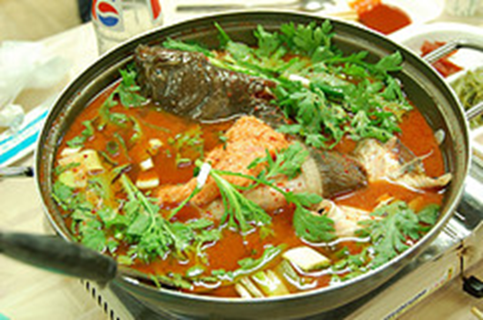
Inputs →Impact illustrated:
The fish soup development story
Courtesy of Ricardo Wilson-Grau
Inspired by Monika Jetzin, GWP Hungary

Slide 40
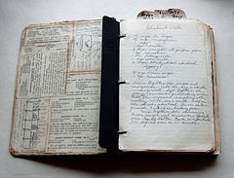

The fish soup development story
The parents follow the great grandmother’s recipe for fish soup.
The quantity and nature of the ingredients are spelled out, as well as the order in how they should be combined.
The parents do not need expertise although of course experience in cooking helps.
If they follow the recipe they will produce basically the same soup week after week.

Slide 41

Inputs or resources
  Parents get together fish, fresh vegetables, water, barley, spices, pot, source of heat
Activities
  Mother or father carefully prepare and cook all the ingredients
Output
  Children are given the most nourishing fish soup in the world
Outcome
  Children consider the soup delicious and eat fish soup once a week for the rest of their lives
Impact
  Children are healthy adults

Slide 42

If only life were so simple!
In the real world, the results can be much less certain.
The great grandmother’s recipe is lost.
Her recommended fish is not available in the market every week of the year.
The family’s buying power varies from year to year.
Children are different and change as they grow:
  One becomes a vegetarian.
  Another goes on a diet.
  A third is simply rebellious.
Outside factors actors influence the children – school, TV, friends and so forth

Slide 43

Inputs or resources
  Parents get together fish, fresh vegetables, water, barley, spices, pot, source of heat
Activities
  Mother or father carefully prepare and cook all the ingredients
Parents control
Output
  Children are given the most nourishing fish soup in the world
Outcome
  Children consider the soup delicious and eat fish soup once a week for the rest of their lives
Parents influence
Impact
  Children are healthy adults
Parents worry

Slide 44
Circles of control, influence and interest/concern/worry
indirect influence
Sphere of interest/concern
Grown up
Child 1
Grown up
Child 2
Grown up
Child 3
direct influence
Sphere of influence
Young child 2
Young child 1
Young child 3
direct control
Sphere of Control
Parents

Slide 45
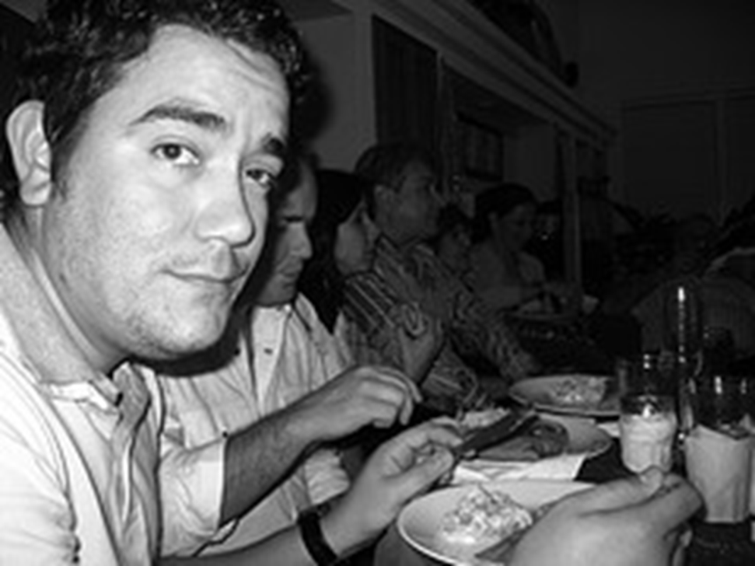
In such a complex situation
The relationships of cause and effect are unknown until the outcomes emerge.
To produce a nutritious soup that their children will eat once a week for the rest of their lives, the recipe is less important than the parents’ relationships with each son and daughter, and theirs with their social environment.
More than cooking experience
parent’s must rely on their
sensitivity and creativity.
And they must accept
uncertainty about the results.

Slide 46
The reality of multi-stakeholder cross-cutting projects is substantially complex
Vision and
Mission
IMPACT
The relationships of cause and effect are unknown
OUTCOMES
OUTPUTS
ACTIVITIES
INPUTS
Plan
Time
Inspired by Jeff Conklin, cognexus.org

Slide 47
In complex situations
Vision and
Mission
OUTCOME
OUTPUT
OUTCOME
OUTPUT
OUTCOME
OUTCOME
ACTIVITY
OUTPUT
OUTCOME
OUTPUT
ACTIVITY
OUTCOME
INPUTS
OUTCOME
ACTIVITY
OUTPUT
INPUTS
ACTIVITY
Plan
Time
INPUTS
INPUTS

Slide 48
Why don’t we measure impact?
EXERCISE
Brainstorm: Why do we not try to measure impact?

Slide 49
Impact Definitions
“Long-term, widespread improvement in society” – World Bank
“Longer term or ultimate result attributable to a development intervention” – OECD
“Long-term and national-level development change” – UNDP
“Ultimate sustainable changes, sometimes attributable to action. ” – Gates Foundation

Slide 50
Impact Definitions
“Long-term, widespread improvement in society” – World Bank
“Longer term or ultimate result attributable to a development intervention” – OECD
“Long-term and national-level development change” – UNDP
“Ultimate sustainable changes, sometimes attributable to action. ” – Gates Foundation

Slide 51
In summary
Programmes & projects operate in a complex and uncertain world
The logic of cause and effect can be effective in simple situations but is challenged by complexity
Impact is long term, attribution is often unrealistic and contribution to impact is often practically impossible to measure
  A project more or less controls outputs
  Only influences outcomes
  And contributes to impact

Slide 52

BUT we are still concerned with impact
Impact is our guiding star but not our measuring stick

Slide 53
Changing the M&E perspective
Old M&E:
M&E is mainly for external funding body
Concentrates on activities and financial reporting
Lots of data and little analysis (big reports!)
Little learning takes place
Little stakeholder participation
M&E is boring and not very useful for project staff and beneficiaries
New M&E
M&E is for everybody involved in project
Also look at effects and outcomes and why there is success and failure
Learning is a key function of M&E
Good analysis on how to improve project
Lots of stakeholder participation
M&E is active, interesting and useful

Slide 54
HOW DO WE MONITOR?
Assess readiness for monitoring
Establish tools for monitoring inputs, processes and outputs
Establish tools for monitoring results/outcomes

Slide 55
Assess readiness for monitoring
Why do we want to embark on setting up a monitoring system?
What are the advantages of setting up a monitoring system?
What are the difficulties people see in monitoring?
What are the necessary supporting measures?
Which incentives can be given to motivate people to monitor?
Who will be the responsible person(s) for designing and enforcing the monitoring system?
Who will be the users of the monitoring system?
What are the users’ needs? What type of information do the users need?
Whose interests and needs are to be given priority?

Slide 56
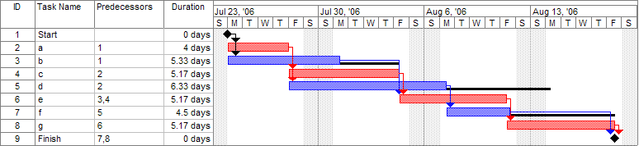
Tools for monitoring inputs, activities and outputs
a) Activities and tasks over time
Gantt charts = breakdown of tasks that must be completed in the required order to achieve a project result

Slide 57
Daily cash book/Journal
Tools for monitoring inputs, activities and outputs
 |  | Cash Advance Nº 1
 |  | Cash Advance No 2
 |  | Total
 |  | Balance after expenditures
Date | Code | Description | Amount |  | Observation
 |  |  | Credit | Debit

Slide 58
Monitoring money & resources (continued)
What does the above table tell us?
It enables you to monitor income and expenditure and to see on a daily basis how you have spent the cash and on what activity
This is a basis upon which you can plan expenditure

Slide 59
Tools for monitoring inputs, activities and outputs
b) Money & resources
Original budget versus actual expenditures as summarised in quarterly financial reports
Budget item | Original budget | Budget spend as per d/m/yr (reporting period x) | Total budget spent | Remaining budget | Deviation from plan
Continued…

Slide 60
Monitoring money & resources (continued)
What does the above table tell us?
The cost of the planned activity at completion.
If the planned and actual expenditure is on schedule or if there are any deviations.
If any variance is within a manageable margin of error.
If all the activities are being carried out as planned.
If there are sufficient financial resources to conduct activities.

Slide 61
Tools for monitoring inputs, activities and outputs
c) Quantity of outputs - Output tracking tools
Date Received | Citation | File name | Type of output | Status (draft, complete) | Follow up action | Notes
11 Jan 09 | EAFRINET brochure featuring the UVIMA Project (2009) | EAFRINET REVISED FLIER JAN 2009.pdf | Brochure | Complete
30 Jul 09 | The UVIMA Project Preparatory Workshop Summary Report. 29th June - 1st July 2009, Lukenya Getaway, Athi River, Kenya. | UVIMA Final Project Preparatory Workshop Report.pdf | Report | Complete
29 Sep 09 | Agwanda, B., Odhiambo, C. & Malaki, P. (2009). Baseline review of taxonomic capacity and infrastructure on pests in Kenya. | 2009-07_UVIMA_Kenya_Baseline_Pests.pdf | Report | Draft | JM to finalise editing & send to PK for formatting
Continued…

Slide 62
Tools for monitoring inputs, processes and outputs
d) Quality of outputs - Quality Assurance Checklists
 |  | To be completed by Author |  | To be completed by Reviewer
REQUIREMENT |  | AUTHOR X‑REFERENCE Page #/Section # | AUTHOR COMMENTS | COMPLY |  | REVIEWER COMMENTS
 |  |  |  | Y | N
1.0 GENERAL INFORMATION
1.1 | Purpose: Describes the purpose of the report
1.2 | Scope: Describes the scope of the report and how it relates to the project.
1.3 | Overview: Provides a brief overview description as a point of reference for the remainder of the report.
1.4 | References: Provides a list of the references that were used in preparation of the report.
1.5 | Acronyms and Abbreviations: Provide a list of the acronyms and abbreviations used in this report and the meaning of each.
1.6 | Points of Contact: Provides a list of points of organisational contact that may be needed by the document users for additional information and support.
Example Quality Assurance Checklist

Slide 63

Getting from Outputs to Outcomes
Reports
Meetings
Training

Slide 64

Tools for Monitoring Outcomes
Outcome Mapping
Adapting the Project Logframe using Outcome Mapping
A highly adaptable participatory planning, monitoring and evaluation approach

Slide 65

Outcome Mapping Framework
INTENTIONAL DESIGN
Vision (your dream)
Mission (your contribution to the vison)
Define desired results/outcomes
Identify & classify stakeholders
Define desired stakeholder outcomes
Define indicators (are we on track?)
Define our strategy (how we contribute to an outcome)
1. PLANNING (INTENTIONAL DESIGN)
What we are trying to accomplish and how?
How do we know we are on track and how can we improve?
Evaluation Plan
3. EVALUATION PLANNING
Monitoring Priorities
Monitoring Processes
2. OUTCOME &
PERFORMANCE MONITORING
What do we want to learn to assess project success?

Slide 66
OM helps a project team
To be specific about the actors it targets, the changes it expects to see and the strategies it employs. =
WHO?
WHAT?
HOW?

Slide 67
Cameroon Biosecurity Project - Logframe
Project Objective
Monitoring of
Results through
Objective level
indicators
What?
Component 1
Objective
Component 2
Objective
Component 3
Objective
Component 4
Objective
WHO?
Output
Output
Output
Monitoring of
Project
Activities &
Output level
Indicators
What?
How?
Project activity
Project activity
Project activity
Who?
Project Management Team (Budget, HR, Organisational Practices)

Slide 68
Cameroon Biosecurity Project - Logframe
Project Objective
Monitoring of
Results through
Objective level
indicators
What?
Component 1
Objective
Component 2
Objective
Component 3
Objective
Component 4
Objective
Output
Output
Output
Monitoring of
Project
Activities &
Output level
Indicators
What?
How?
Project activity
Project activity
Project activity
Who?
Project Management Team (Budget, HR, Organisational Practices)

Slide 69
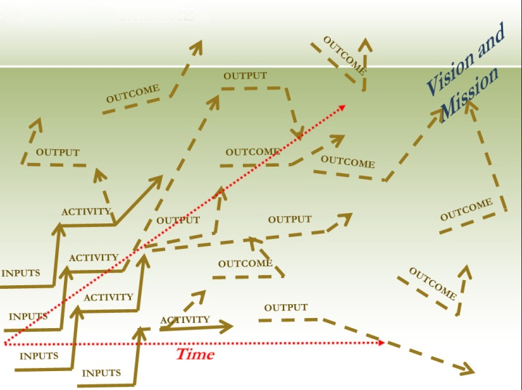
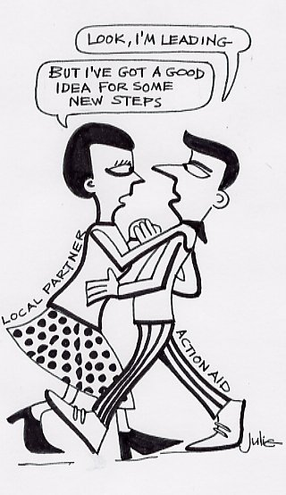
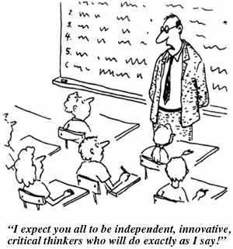
Inter-related challenges that stimulated the development of OM
Changes are complex and do not move in a linear way
A project can influence outcomes but cannot control them
Development is done by and for people
Non-causality
Control of change
Contribution not attribution
Notes:
Three important principles in OM are:
1) Non-causality: Outcomes can be logically linked to a project’s activities but they are not necessarily directly caused by them.
3) Control of change / development: Outcome Mapping assumes that the boundary partners control change and that projects only facilitate the process by providing access to new resources, ideas, or opportunities for a certain period of time.
2) Contribution instead of attribution: When applying OM, a project is not claiming the achievement of development impacts; rather, the focus is on its contributions to outcomes. The logic behind this is that long-term development goals are rarely accomplished by the work of a single actor and that the complexity of the development process makes it extremely difficult to actually assess impact.

Slide 70
Principles of use
Flexibility
  OM needs to be adapted to use in your specific context.
  It is not a fixed route but a guide for the journey we take.
Participatory
  OM implies dialogue and collaboration with partners.
  We co-create the ´map´ with our partners.
Evaluative thinking
  Fosters a reflective practice, organisational & social learning.
Continued…

Slide 71
Attribution or Contribution?
How does your project make a difference?
project influence decreases
community capacity & ownership increases

Slide 72
The focus of Outcome Mapping
Project influence decreases (is replaced)
changed behavior
Stakeholder capacity & ownership increases

Slide 73
Brief definition of OM
A participatory method for planning, monitoring and evaluation;
Focuses on changes in behaviour of those with whom the project or programme works; and
Oriented towards social change & organisational learning

Slide 74
Using OM to monitor results
PLANNING (INTENTIONAL DESIGN)
What we are trying to accomplish & how
INTENTIONAL DESIGN
Vision (your dream)
Mission (your contribution to the vison)
Define desired results/outcomes
Identify & classify stakeholders
Define desired stakeholder outcomes
Define indicators (are we on track?)
Define our strategy (how we contribute to an outcome)
2. OUTCOME & PERFORMANCE MONITORING
How we know we are on track & how we can improve
Prepare a monitoring plan

Slide 75
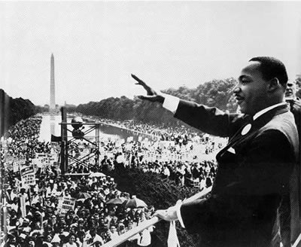
Using OM to monitor results
Step 1: Define your Vision

Slide 76
Using OM to monitor results
Step 1: Define your Vision
PLANNING (INTENTIONAL DESIGN)
What we are trying to accomplish & how
INTENTIONAL DESIGN
VISION (your dream)
MISSION (your contribution to the vison)
Define desired results/outcomes
Identify & classify stakeholders
Define desired stakeholder outcomes
Define indicators (are we on track?)
Define our strategy (how we contribute to an outcome)
2. OUTCOME & PERFORMANCE MONITORING
How we know we are on track & how we can improve
Prepare a monitoring plan

Slide 77

Step 1: Define your vision
Vision
improved human, social, & environmental wellbeing

Slide 78


The Vision
Description of the universe in terms of human, social, economic or environmental conditions
Large-scale development-related changes
Describes the ideal world
Beyond project's capability
Functions as a lighthouse – something to guide movement
…and a star – something big to aim for
Written in future and present tense

Slide 79
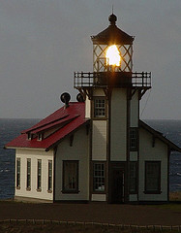


A vision statement..
guides
motivates and inspires
is an ‘accountability-free zone’
Notes:
Vision describes why the project is involved in development work
It is the beacon that guides day-to-day work
Probably won’t change for the life of the project
It articulates the values of the programme
The vision goes beyond what the project alone can bring about but it will contribute
The project is never measured against its vision
It provides an inspirational focus for the project
It is the ideal that the project wants to bring about

Slide 80
I have a set of objectively verifiable indicators!
Martin Luther King, Jr.
August 28, 1963
Notes:
MLK’s address to the largest civil rights demonstration in US history on the steps of the Lincoln Memorial in Washington DC - affected generations of social change
DID NOT say “I have a set of objectively verifiable indicators”
Described actions - what children, families, etc. would be doing differently if the USA were not a racially divided country
Dr. Martin Luther King Jr. had originally prepared a short and somewhat formal recitation of the sufferings of African Americans attempting to realize their freedom in a society chained by discrimination. He was about to sit down when gospel singer Mahalia Jackson called out, "Tell them about your dream, Martin! Tell them about the dream!" Encouraged by shouts from the audience, King drew upon some of his past talks, and the result became the landmark statement of civil rights in America -- a dream of all people, of all races and colors and backgrounds, sharing in an America marked by freedom and democracy. He said:
“…I have a dream that one day on the red hills of Georgia the sons of former slaves and the sons of former slave owners will be able to sit down together at the table of brotherhood.
I have a dream that one day even the state of Mississippi, a state sweltering with the heat of injustice.. [and] …oppression, will be transformed into an oasis of freedom and justice.
I have a dream that my four little children will one day live in a nation where they will not be judged by the color of their skin but by the content of their character…
I have a dream that one day down in Alabama… little black boys and black girls will be able to join hands with little white boys and white girls as sisters and brothers.”

Slide 81
I have a dream!
Martin Luther King, Jr.
August 28, 1963
Notes:
MLK’s address to the largest civil rights demonstration in US history on the steps of the Lincoln Memorial in Washington DC - affected generations of social change
DID NOT say “I have a set of objectively verifiable indicators”
Described actions - what children, families, etc. would be doing differently if the USA were not a racially divided country
Dr. Martin Luther King Jr. had originally prepared a short and somewhat formal recitation of the sufferings of African Americans attempting to realize their freedom in a society chained by discrimination. He was about to sit down when gospel singer Mahalia Jackson called out, "Tell them about your dream, Martin! Tell them about the dream!" Encouraged by shouts from the audience, King drew upon some of his past talks, and the result became the landmark statement of civil rights in America -- a dream of all people, of all races and colors and backgrounds, sharing in an America marked by freedom and democracy. He said:
“…I have a dream that one day on the red hills of Georgia the sons of former slaves and the sons of former slave owners will be able to sit down together at the table of brotherhood.
I have a dream that one day even the state of Mississippi, a state sweltering with the heat of injustice.. [and] …oppression, will be transformed into an oasis of freedom and justice.
I have a dream that my four little children will one day live in a nation where they will not be judged by the color of their skin but by the content of their character…
I have a dream that one day down in Alabama… little black boys and black girls will be able to join hands with little white boys and white girls as sisters and brothers.”

Slide 82
MLK’s Vision
“…I have a dream that one day on the red hills of Georgia the sons of former slaves and the sons of former slave owners will be able to sit down together at the table of brotherhood.
I have a dream that one day even the state of Mississippi, a state sweltering with the heat of injustice.. [and] …oppression, will be transformed into an oasis of freedom and justice.
I have a dream that my four little children will one day live in a nation where they will not be judged by the color of their skin but by the content of their character…
I have a dream that one day down in Alabama… little black boys and black girls will be able to join hands with little white boys and white girls as sisters and brothers.”
Described actions - what children, families, etc. would be doing differently if the USA were not a racially divided country

Slide 83
Vision Facilitation Exercise: I have a dream
Imagine that, 5-10 years from now, the project has been extremely successful. Things have improved beyond your most ambitious dreams.
  What changes have occurred?
  What (& how) are your target communities (“beneficiaries”) doing?
  What are your partners doing?
(In essence: describe the world you are seeking to help create.)
Notes:
Be visionary and idealistic, but stay in reality – make it useful to you as a guide
Visions can be as long or as short as the project wants so long as people agree on that it represents the ideal they’re striving to help bring about.
Dream boldly !

Slide 84
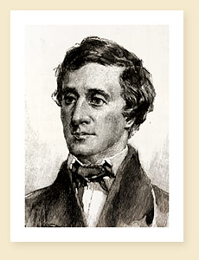
If you have built castles in the air, your work need not be lost; that is where they should be. Now put foundations under them.
Henry David Thoreau
Notes:
Wikipedia Entry: Henry David Thoreau (July 12, 1817 – May 6, 1862) was an American author, poet, philosopher, abolitionist, naturalist, tax resister, development critic, surveyor, historian, and leading transcendentalist. He is best known for his book Walden, a reflection upon simple living in natural surroundings, and his essay Civil Disobedience, an argument for individual resistance to civil government in moral opposition to an unjust state.

Slide 85

Step 2: Define your mission
The mission is that “bite” of the vision statement on which the project is going to focus.

Slide 86
Using OM to monitor results
Step 2: Mission
PLANNING (INTENTIONAL DESIGN)
What we are trying to accomplish & how
INTENTIONAL DESIGN
Vision (your dream)
MISSION (your contribution to the vison)
Define desired results/outcomes
Identify & classify stakeholders
Define desired stakeholder outcomes
Define indicators (are we on track?)
Define our strategy (how we contribute to an outcome)
2. OUTCOME & PERFORMANCE MONITORING
How we know we are on track & how we can improve
Prepare a monitoring plan

Slide 87
A mission statement describes:
How the project intends to apply its resources in support of the vision
The areas in which the project intends to work
How the project will support the achievement of outcomes by its direct partners
Written in the future tense -
as something the project will do

Slide 88
Your mission is your “business”
What do you do?
Who are your principal collaborators?
How do you work with them?
By what time?
Think of a mission as instructions from your boss:
By this time you should have done this together with them in this way

Slide 89
Mission Facilitation Questions
  What areas do you need to work in?
  What do you need to do in these areas?
  Who can you work with?
  How will you stay effective, efficient, and relevant?
(In essence: How will the project contribute to the Vision.)
Notes:
Be visionary and idealistic, but stay in reality – make it useful to you as a guide
Visions can be as long or as short as the project wants so long as people agree on that it represents the ideal they’re striving to help bring about.
Dream boldly !

Slide 90

Summary
Vision
Mission
About the future
Idealistic
Not about the project
About the present & future
Feasible
About the project

Slide 91
Using OM to monitor the achievement of results
Define your vision (your dream) & mission (how you can contribute to the vision)
Define desired results/outcomes
  Identify & classify stakeholders
  Define desired stakeholder outcomes
Define indicators (are we on track?)
Define our strategy (how we contribute to an outcome)
Prepare a monitoring plan

Slide 92

Using OM to monitor results
Step 3: Identify & classify stakeholders

Slide 93

Using OM to monitor results
Step 3: Identify & classify stakeholders
PLANNING (INTENTIONAL DESIGN)
What we are trying to accomplish & how
INTENTIONAL DESIGN
Vision (your dream)
Mission (your contribution to the vison)
Define desired results/outcomes
Identify & classify stakeholders
Define desired stakeholder outcomes
Define indicators (are we on track?)
Define our strategy (how we contribute to an outcome)
2. OUTCOME & PERFORMANCE MONITORING
How we know we are on track & how we can improve
Prepare a monitoring plan

Slide 94
Stakeholder Circles: A project cannot control change, it can only influence and contribute to changes at the level of its direct partners
indirect influence
Sphere of interest/concern
Community1
Community 2
Community 3
direct influence
Sphere of influence
Direct partner 2
Direct partner 1
Direct partner 3
direct control
Sphere of Control
Implementing team

Slide 95
Stakeholder Circles for the Cameroon Biosecurity Project
Plant Breeders
Fisherfolk
Affected communities
Consumers
Farmers
Seed Producers
Decision-makers (outside Parliament)
Pilot site
authorities
UNEP/GEF
Extension workers
Donors
Parliament
Biologists,
Ecologists
& researchers
Agro-industry
Cameroon Academy of Science
Sphere of
Concern
Consumers
Association
Civil society orgs
Involved Ministries:
MINADER
MINEPIA
MINEPDED
MINCOMMERCE
MINFI (Customs)
MINESUP
MINRESI
MINFOF
MINSANTE
Governments in neighbouring countries
Trade
Association
Civil society/NGOs
Sphere of Influence
Medical personnel
PCU
Sphere of Control
Traders
Pastoralists

Slide 96
Which of these are your “Boundary Partners”?
Who do you aim to inspire, persuade, support or encourage?
Those individuals, groups, and organizations – from civil society, government or business – with whom you:
Interact directly to effect change
Anticipate opportunities for change
Will engage in mutual learning

Slide 97
Boundary Partners have Boundary Partners
BP’s BPs
Project’s BPs
Project

Slide 98
The Serenity Prayer
God, grant me the serenity to accept the things I cannot change,
The courage to change the things I can,
And the wisdom to know the difference.

Slide 99
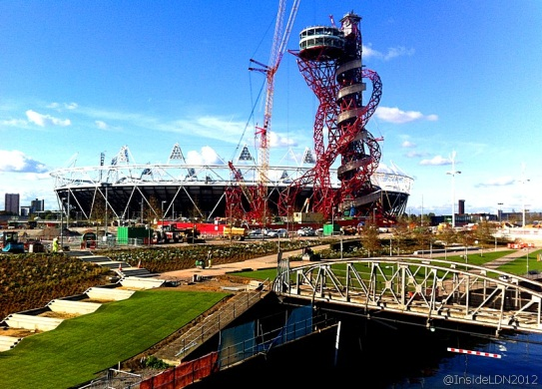
Using OM to monitor results
Step 4: Define desired stakeholder outcomes

Slide 100
Using OM to monitor results
Step 4: Define desired stakeholder outcomes
PLANNING (INTENTIONAL DESIGN)
What we are trying to accomplish & how
INTENTIONAL DESIGN
Vision (your dream)
Mission (your contribution to the vison)
Define desired results/outcomes
Identify & classify stakeholders
Define desired stakeholder outcomes
Define indicators (are we on track?)
Define our strategy (how we contribute to an outcome)
2. OUTCOME & PERFORMANCE MONITORING
How we know we are on track & how we can improve
Prepare a monitoring plan

Slide 101
Step 4: Define desired stakeholder outcomes
Can your Boundary Partners behave in new ways which support the project’s Mission & contribute to its Vision?
How would your Boundary Partners behave if the project was extremely successful?
These stakeholder outcomes are known as Outcome Challenges.

Slide 102
Outcome Challenge characteristics
One for each boundary partner
Describes the boundary partners’ ideal (but possible) contribution to the vision
Written like this: “The project intends to see [Boundary Partner] who [description of behaviours in the active present tense]”

Slide 103
Outcome Challenge Facilitation Questions
Ideally, in order to contribute to the Vision, how would the Boundary Partner be behaving?
With whom would they be interacting?
What would they be doing to contribute maximally to the vision?

Slide 104
Example Outcome Challenge statement
St²eep intends to see college administrators who continually support environmental education activities within the colleges by:
appointing full–time environmental education coordinators and
providing office space, transport, equipment, finances, communication and other resources for successful environmental education implementation.
They are actively supporting policy development and implementation by:
recognising that environmental education is part and parcel of the curriculum and college functions and
incorporating environmental education in the college strategic plan.
They are cooperating with St²eep by:
attending environmental education organised functions.

Slide 105

Using OM to monitor results
Step 5: Define indicators

Slide 106
Using OM to monitor results
Step 5: Define indicators
PLANNING (INTENTIONAL DESIGN)
What we are trying to accomplish & how
INTENTIONAL DESIGN
Vision (your dream)
Mission (your contribution to the vison)
Define desired results/outcomes
Identify & classify stakeholders
Define desired stakeholder outcomes
Define indicators (are we on track?)
Define our strategy (how we contribute to an outcome)
2. OUTCOME & PERFORMANCE MONITORING
How we know we are on track & how we can improve
Prepare a monitoring plan

Slide 107
Step 5: Define Progress markers (“Progress Indicators”)
Describe changes in actions, activities and relationships leading to the ideal outcome
Articulate the complexity of the change process
Can be monitored & observed
Enable on-going assessment of partner’s progress (including unintended results)

Slide 108
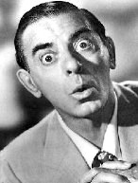
Change is a process not an event
It took me 20 years to become an overnight success!
Change is a process not an event
Progress markers help us to break down the change & process and adapt our strategy to it
Progress markers are like mini Outcome Challenges
Eddie Cantor
Notes:
Wikipedia entry: Eddie Cantor (January 31, 1892 – October 10, 1964), born Edward Israel Iskowitz, was an American "illustrated song" performer, comedian, dancer, singer, actor and songwriter. Familiar to Broadway, radio, movie and early television audiences, this "Apostle of Pep" was regarded almost as a family member by millions because his top-rated radio shows revealed intimate stories and amusing anecdotes about his wife Ida and five daughters. Some of his hits include "Makin' Whoopee," "Ida," "If You Knew Susie," "Ma! He's Makin' Eyes at Me," "Margie" and "How Ya Gonna Keep 'Em Down on the Farm (After They've Seen Paree?)" He also wrote a few songs, including "Merrily We Roll Along," the Merrie Melodies Warner Bros. cartoon theme.

Slide 109

The Outcome Challenge alone is not sufficient
We need indicators (“markers”)
to help us to assess whether we are on track?

Slide 110

Journey to the Olympics

Slide 111
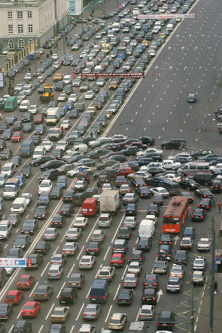
Change is usually gradual
“You cannot change your systems overnight and you cannot change them all at once. A country can change the side of the road it drives on overnight, but not without huge education programmes, changes in signposts and traffic systems and accepting the inevitability of a certain number of accidents.” Barefoot Guide 2: Learning practices in organisations and social change

Slide 112

Progress Markers
(ladders of change)
Love to see
Reaching the Outcome Challenge and sustaining the change
Expanding influence, helping others, sharing expertise, building support networks, etc.
Like to see
Decision stage
Actively engaged, making a commitment
Expect to see
Awareness & Preparation stage
Early encouraging response to project, initial engagement, recognition there is a need to change; obtaining new knowledge

Slide 113
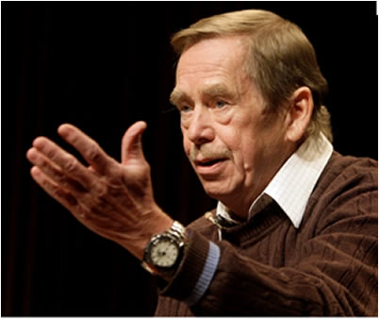
Va'clav Havel
Vision is not enough; it must be combined with venture. It is not enough to stare up to the step; we must step up the stairs…
Notes:
Wikipeda entry: Václav Havel; 5 October 1936 – 18 December 2011) was a Czech playwright, essayist, poet, dissident and politician.

Slide 114
Example Progress Markers
The Project Expects to See College Administrators:
Authorising lecturers to participate in environmental education activities.
Providing office space and equipment for the environmental education coordinators.
The Project would Like to See College Administrators :
Providing transport, finances and other resources for environmental education activities.
Including and positioning environmental education, high on the agenda of staff meetings.
The Project would Love to See College Administrators :
Incorporating environmental education in the college strategic plan.
Appointing full time environmental education coordinators.

Slide 115

Using OM to monitor results
Step 6: Define our Strategy

Slide 116
Using OM to monitor results
Step 6: Define our Strategy
PLANNING (INTENTIONAL DESIGN)
What we are trying to accomplish & how
INTENTIONAL DESIGN
Vision (your dream)
Mission (your contribution to the vison)
Define desired results/outcomes
Identify & classify stakeholders
Define desired stakeholder outcomes
Define indicators (are we on track?)
Define our strategy (how we contribute to an outcome)
2. OUTCOME & PERFORMANCE MONITORING
How we know we are on track & how we can improve
Prepare a monitoring plan

Slide 117









6 interlinked kinds of strategies
 | causal | persuasive | supportive
I aimed at individual boundary partner
E aimed at boundary partner’s environment

Slide 118
 | causal | persuasive | supportive
I aimed at individual boundary partner
E aimed at boundary partner’s environment

Slide 119
6 interlinked kinds of strategies
 | causal | persuasive | supportive
I aimed at individual boundary partner | strong influence | arouse new thinking; build skills, capacity | on-going support
E aimed at boundary partner’s environment | alter the physical, regulatory or information environment | broad information dissemination; access to new info | create / strengthen peer networks

Slide 120
Facilitation Questions
causal
persuasive
supportive
How will sustained support, guidance or mentoring be provided?
What will be done to produce immediate outputs?
I
aimed at individual boundary partner
What will be done to build capacity?
E
aimed at boundary partner’s environment
What networks or relationships will be established or utilized?
What will be done to alter the physical or policy environment?
How will the media or publications be used?

Slide 121

Using OM to monitor results
Step 7: Prepare a Monitoring Plan

Slide 122
Using OM to monitor results
Step 7: Prepare a Monitoring Plan
PLANNING (INTENTIONAL DESIGN)
What we are trying to accomplish & how
INTENTIONAL DESIGN
Vision (your dream)
Mission (your contribution to the vison)
Define desired results/outcomes
Identify & classify stakeholders
Define desired stakeholder outcomes
Define indicators (are we on track?)
Define our strategy (how we contribute to an outcome)
2. OUTCOME & PERFORMANCE MONITORING
How we know we are on track & how we can improve
Prepare a monitoring plan

Slide 123
Cameroon Biosecurity Project - Logframe
Project Objective
Monitoring of
Results through
Objective level
indicators
What?
Component 1
Objective
Component 2
Objective
Component 3
Objective
Component 4
Objective
WHO?
Output
Output
Output
Monitoring of
Project
Activities &
Output level
Indicators
What?
How?
Project activity
Project activity
Project activity
Who?
Project Management Team (Budget, HR, Organisational Practices)

Slide 124
Cameroon Biosecurity Project - Logframe
Project Objective
Monitoring of
Results through
Objective level
indicators
What?
Component 1
Objective
Component 2
Objective
Component 3
Objective
Component 4
Objective
Output
Output
Output
Monitoring of
Project
Activities &
Output level
Indicators
What?
How?
Project activity
Project activity
Project activity
Who?
Project Management Team (Budget, HR, Organisational Practices)

Slide 125
Cameroon Biosecurity Project - Adapted Logframe
Project Objective
Vision
sphere of interest
Monitoring of
Results through
Objective level
indicators
Component 1
Objective
Component 2
Objective
Component 3
Objective
Component 4
Objective
Boundary
Partner A
Boundary
Partner A
Boundary
Partner A
Monitoring of
Boundary Partner
Outcomes through
Progress Markers
sphere of influence
Outcome Challenge
Outcome Challenge
Outcome Challenge
Progress
Markers
Progress
Markers
Progress
Markers
Output
Output
Output
Monitoring of
Project
Activities &
Output level
Indicators
sphere of control
Project activity
Project activity
Project activity
Project Management Team (Budget, HR, Organisational Practices)
Mission

Slide 126
Intervention logic
Monitoring tool
Summary
reports
Project Objective
Logframe tracking form
sphere of interest
Component
Objective
UNEP Half-Yearly Report
UNEP Project Implementation Report
Boundary
Partner
sphere of influence
Outcome Challenge
Partner Outcome Monitoring Form
Progress
Markers
Output
Gantt charts
Logframe & other tracking forms
Quality Assurance checklists
Meeting evaluation forms
sphere of control
Project activity
Inputs
Gantt charts
Project financial reports

Slide 127
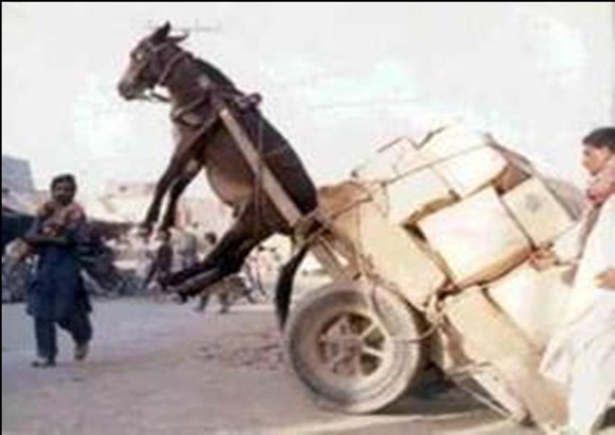
BUT THE SYSTEM SHOULD NOT BE TOO HEAVY!!
Gracias a Michael Quinn Patton

Slide 128
The PBME System for the Cameroon Biosecurity Project
    Monitoring inputs
    Monitoring activities & outputs
    Monitoring outcomes
    Monitoring objectives
    Implementation of the system

Slide 129
Monitoring inputs
Monitoring money
    Daily Financial Records
    Financial Reporting
    Cash Advances
    Co-financing
Monitoring resources:
    Inventory of non-expendable equipment
    Equipment transfer letter
Monitoring time:
    Gantt chart
    logframe tracking form

Slide 130
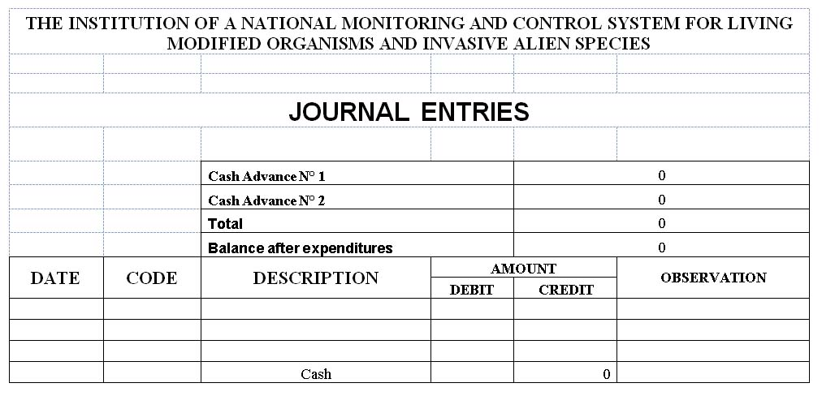
Monitoring inputs – Money
Daily Financial Records
It is the PCU’s responsibility to maintain current, complete and accurate financial records for project funds. This is done by logging all expenditure and money received (cash advances or credit) in a daily cash book or journal

Slide 131
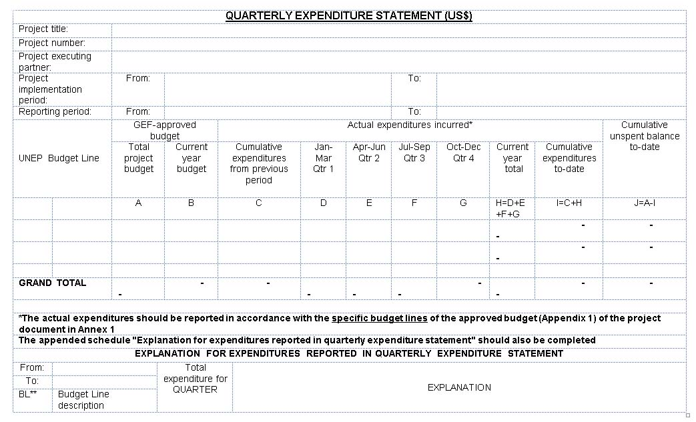
Monitoring inputs – Money
Financial Reporting
Details of expenditures are reported on an activity by activity basis as at 31 March, 30 June, 30 September and 31 December using the format given in the Quarterly Expenditure Statement

Slide 132
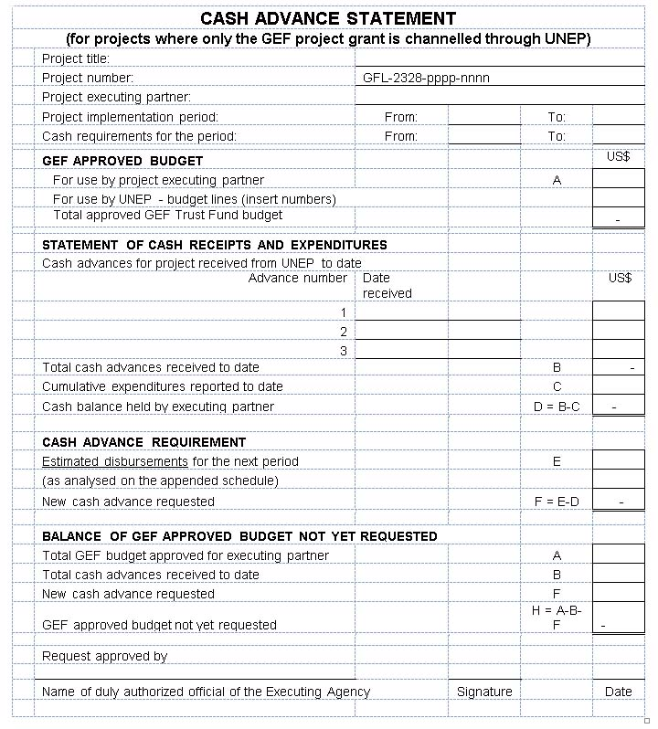
Monitoring inputs – Money
Cash Advances
Advances are made quarterly, subject to: i) Confirmation by the PCU that the expected rate of expenditure and actual cash position necessitate the payment; ii) A satisfactory financial report showing expenditures incurred for the past quarter, under each project activity; iii) A satisfactory report on project implementation.
Requests are made using the Cash Advance Statement format

Slide 133
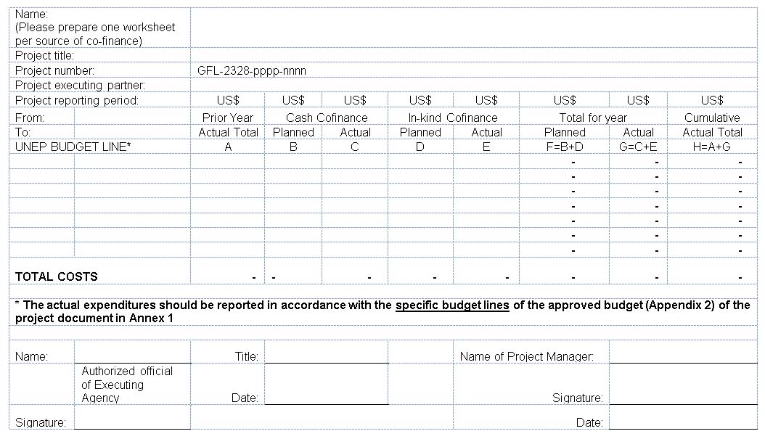
Monitoring inputs – Money
Co-financing
In-kind co-financing is recorded in the daily cash book or journal. Cash and in-kind co-financing are recorded in the report of planned and actual co-finance by budget line

Slide 134
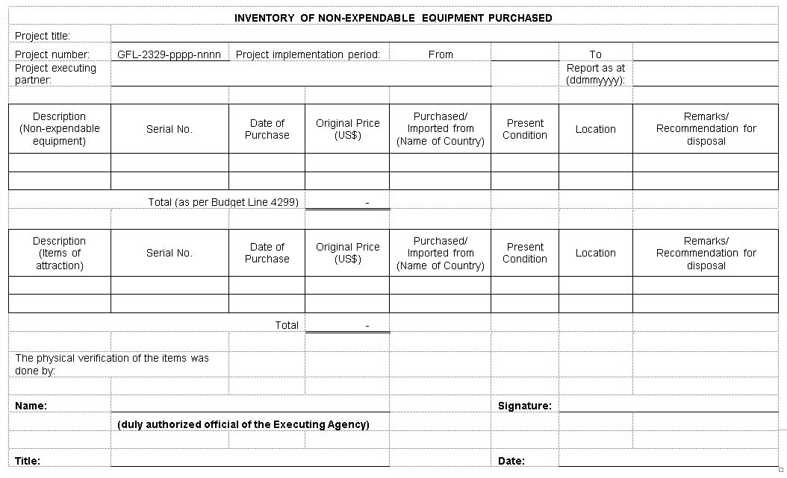
Monitoring inputs – Resources
Inventory of non-expendable equipment
All items of non-expendable equipment bought using GEF funds of a value of US$1,500 or above are recorded in the inventory of non-expendable equipment. In addition, items of attraction are listed. These are items with a purchase value in excess of US$100 that PCU wants to keep track of.

Slide 135
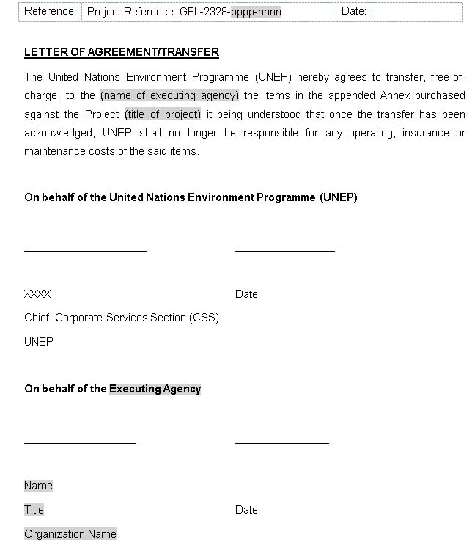
Monitoring inputs – Resources
Equipment transfer letter
Non-expendable equipment remains the property of UNEP until the end of the project when they are transferred to the executing agency through a letter of agreement/[equipment] transfer

Slide 136
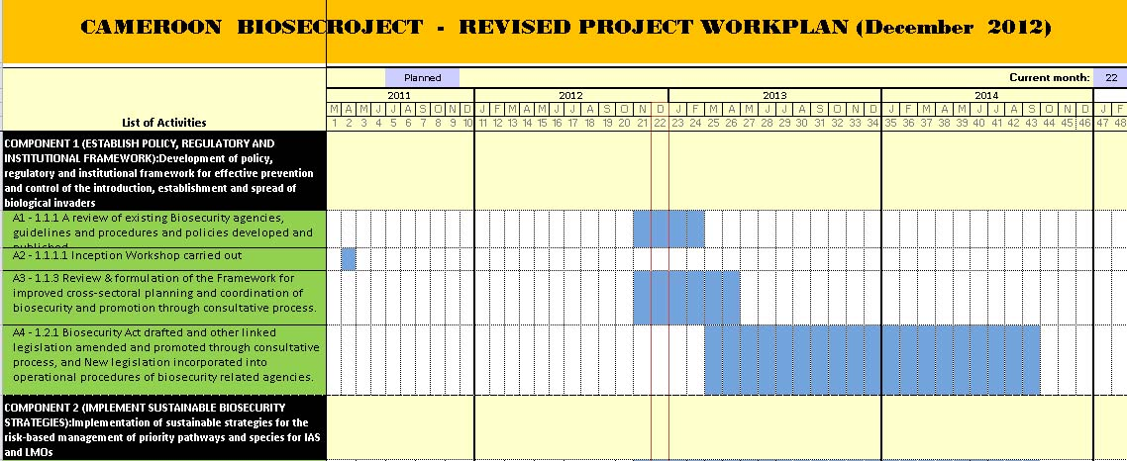
Monitoring inputs – Time
Gantt Chart
Activities are planned using a Project Gantt Chart

Slide 137
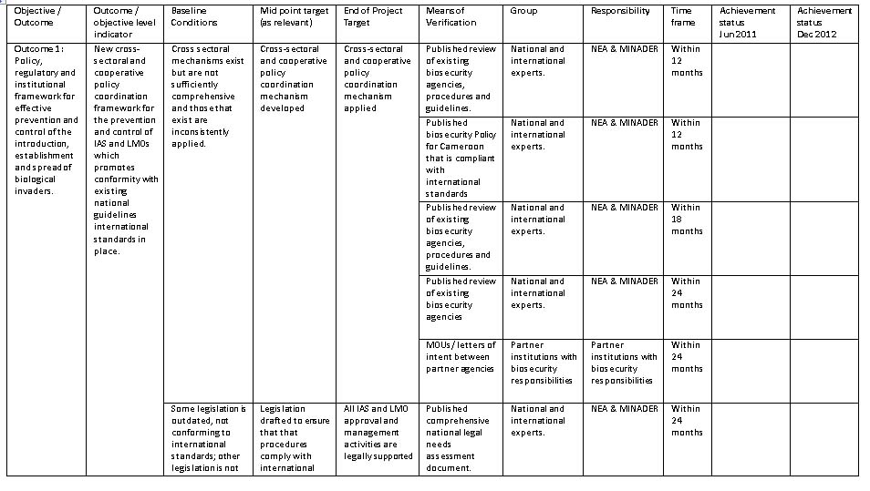
Monitoring inputs – Time logframe tracking form
Activities are monitored against the project Gantt chart using the logframe tracking form, a form documenting progress against the logical framework matrix

Slide 138
Monitoring activities & outputs
Project Gantt chart and logframe tracking form (outlined above)
Output tracking form
Output quality assurance checklists
Output evaluation forms

Slide 139
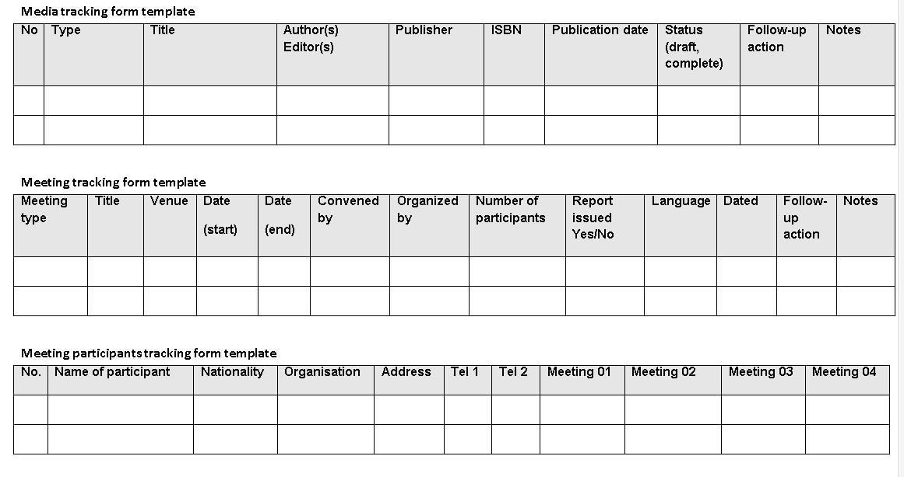
Monitoring activities & outputs
Output tracking form(s)
Outputs, the products of project activities, are monitored through various output tracking forms examples of which are shown below

Slide 140
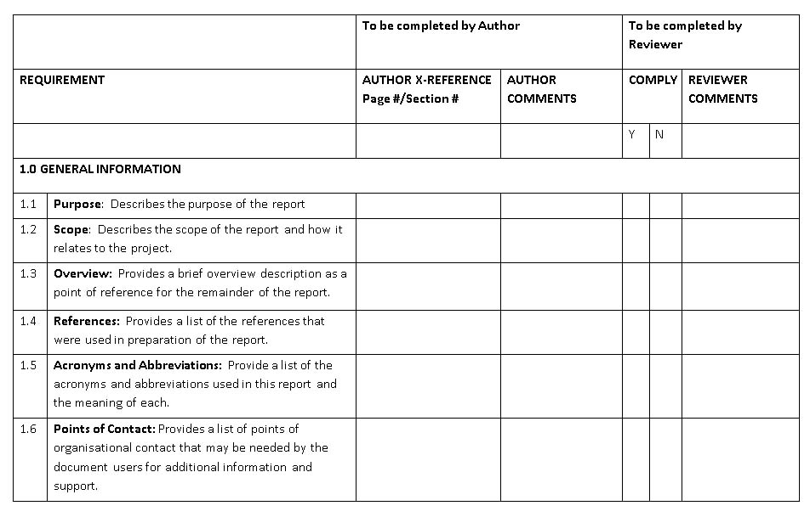
Monitoring activities & outputs
Output quality assurance checklists
Output quality assurance checklists are used in order to monitor the quality of the outputs produced. The exact nature of the checklist will depend upon the specific activity. An excerpt from a typical QA checklist template is shown below.

Slide 141
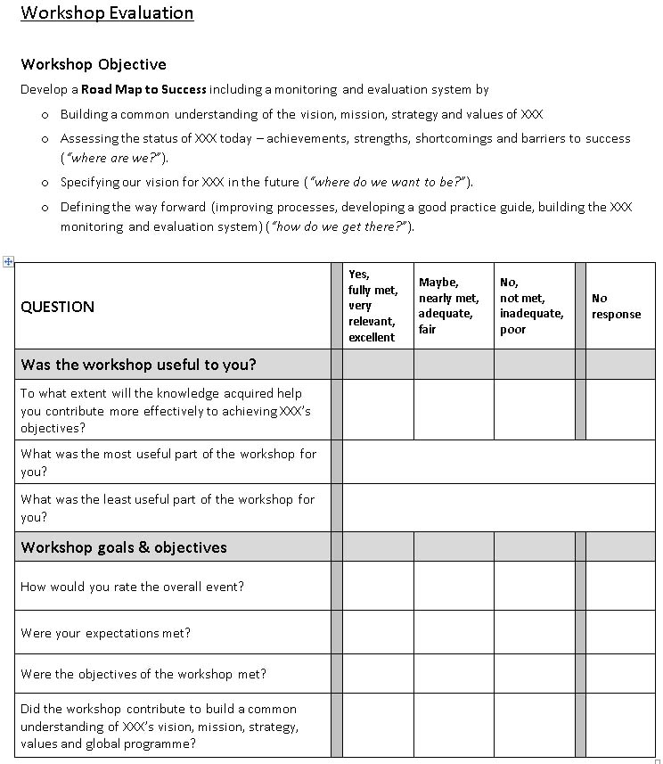
Monitoring activities & outputs
Output evaluation forms
Certain activities such as training are evaluated by participants upon completion. Evaluation forms are produced on a case by case basis. Typically the following should be assessed for a training activity: the degree to which the activity achieved its stated objective; the clarity of the training agenda, the clarity of the presentations given, the quality of the resources provided, the quality of logistical support, and suggested next steps. An excerpt of a typical meeting evaluation form is shown here

Slide 142
Monitoring outcomes
Partner outcome monitoring form
Logframe tracking form (outlined above)

Slide 143
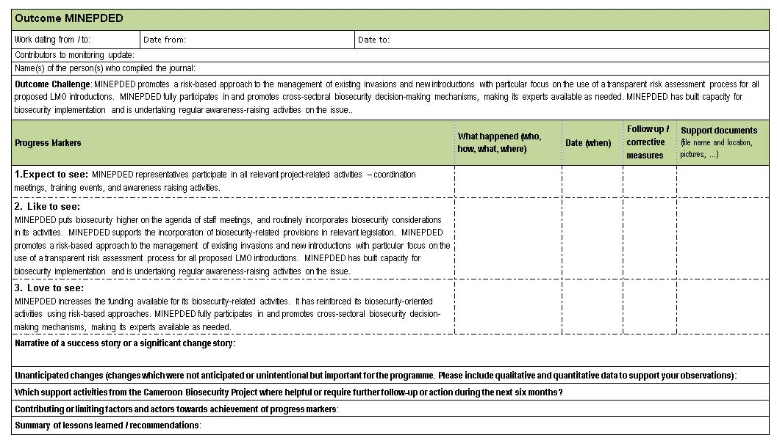
Monitoring outcomes
Partner outcome monitoring form
The progress towards Outcome Challenges will be summarised in a Partner Outcome Monitoring Form which will be completed at the six monthly monitoring meeting

Slide 144
Monitoring objectives
Changes in baseline indicators
Changes in component outcomes

Slide 145
Monitoring objectives
Changes in baseline indicators
Specific project activities will be undertaken to gather baseline information. For example baseline knowledge and attitudes concerning biological invasions in Cameroon have been derived (Mauremootoo and Frambo 2012) and follow-up surveys will assess changes with project implementation.
The following baseline assessments in other relevant areas will be completed:
  legal, policy, and institutional biosecurity framework of Cameroon; Cameroon’s biosecurity profile from trade and other activities
  the social, cultural, economic, environmental and biological impact of priority invasive species in Cameroon
  the extent and impact of target species in pilot sites.
The legal, policy and institutional biosecurity framework and pilot site impacts would be expected to change with project implementation but changes in pathways and impacts of priority invasive species at the national level are less likely. Therefore greater relative effort will be expended in monitoring those parameters that are likely to be associated with successful project execution during the period of project implementation.

Slide 146
Monitoring objectives
Changes in component outcomes
Although the Component Outcomes do not have corresponding objectively verifiable indicators, means of verification and risks and assumptions, it may still be possible for the project to provide information about the degree to which the project has contributed towards the attainment of these outcomes. This information can be provided by synthesising results from the other monitoring processes. Such a synthesis can be a simple compilation of relevant monitoring records or a more systematic process e.g. the use of the Most Significant Change technique (Davies and Dart 2005).

Slide 147
Implementation of the system
The PCU will coordinate the system, using the approaches outlined. This system will be based around the following elements:
Monitoring of project inputs, activities, outputs and outcomes by the PCU (overall responsibility).
Monitoring of inputs, activities and outputs and outcomes at the component level by Component Task Teams.
Implementation of the monitoring aspects of specific activities by those responsible for their execution e.g. consultants, Task Teams and pilot site implementation teams.
Monitoring will consist of
Activity-specific monitoring
Ongoing monitoring
Periodic monitoring

Slide 148
Implementation of the system
Activity-specific monitoring
All activities will have specific monitoring requirements in terms of accounting for inputs, undertaking activities and producing outputs. The results of certain activities (e.g. baseline and follow-up surveys), also feed into the Project’s outcome monitoring system. Activity monitoring is the responsibility of those executing the activity under the oversight of the relevant Component Task Team who reports to the PCU.

Slide 149
Implementation of the system
Ongoing monitoring
Day to day monitoring is undertaken by those responsible for undertaking activities, Task Teams and the PCU. The results of this ongoing monitoring feed into the periodic monitoring.

Slide 150
Implementation of the system
Periodic monitoring
Periodic monitoring is based on the UNEP reporting calendar. The following reports are needed by UNEP:
Quarterly Financial Reports – for the three month periods to 31 March, 30 June, 30 September and 31 December. These reports consist of: the Quarterly Expenditure Statement; Cash Advance Statement; report of planned and actual co-finance by budget line; and the NXE report. These reports are responsibility of the PCU.
Half- yearly reports - for the six months from July – December (to be submitted by 31 January the following year). This is the responsibility of the PCU who compiles the report using inputs received by project partners. The half-yearly report details progress in project implementation, external and internal risks and risk management, M&E activities, and details of staffing, sub-contracts and meetings.
Project Implementation Report (PIR) or annual report for the year from July – June. This is the responsibility of the PCU who compiles the report in an iterative process with the UNEP Project Task Manager using inputs received by project partners. The PIR covers the same areas as the half-yearly report but also contains ratings on project risk, project progress towards meeting project objective(s), project implementation progress and actions to be taken (or that have been taken) if the project’s implementation progress is deemed to be less than satisfactory.

Slide 151
Implementation of the system
Periodic monitoring: Partner Meetings
A participatory system can only rely on the PCU for facilitation but must have full involvement of the Boundary Partners if it is to be effective. Therefore, regular monitoring meetings are essential. The purpose of these 1-2 day meetings will be for the BPs to report, reflect, learn and provide inputs into the planning process. The fact that these meetings will involve a range of partners also provides an opportunity to network and learn from each-other’s experiences. These meetings will take place at six month intervals, several weeks before the half-yearly reports are due. This will provide the PCU with sufficient time to synthesise the information received from these meetings into the format required by UNEP.

Slide 152
External Evaluation
Mid-term evaluation & Terminal evaluation
There are two scheduled external independent project evaluations; the mid-term evaluation and the terminal evaluation.
The general objectives of the mid-term evaluation is to assess progress to date; to re-evaluate the design and direction of the project in terms of constraints or opportunities which may have emerged during the initial implementation; and to identify and disseminate lessons learned.
The objective of the terminal evaluation is to examine the extent and magnitude of any project impacts to date and determine the likelihood of future impacts. The evaluation will also assess project performance and the implementation of planned project activities and planned outputs against actual results.

Slide 153
Intervention logic
Monitoring tool
Summary
reports
Project Objective
Logframe tracking form
sphere of interest
Component
Objective
UNEP Half-Yearly Report
UNEP Project Implementation Report
Boundary
Partner
sphere of influence
Outcome Challenge
Partner Outcome Monitoring Form
Progress
Markers
Output
Gantt charts
Logframe & other tracking forms
Quality Assurance checklists
Meeting evaluation forms
sphere of control
Project activity
Inputs
Gantt charts
Project financial reports

Slide 154
5 things to remember about PME…
Understanding is more valuable to donors than attribution.
There is power in systematically collected and used monitoring data.
People don’t always know what they want until they see it.
Changed relationships may be more significant than changes in state.
There is no ‘end destination’, change keeps on going.

Slide 155

Embrace Complexity
Look at the bigger picture
See yourself as a part of an interconnected web of relationships and systems

Slide 156

Change is constant
“It’s not possible to see the same river twice” Heraclitus

Slide 157

Recognise that change is…
Continuous
Complex
Non-linear
Not controllable
Multidirectional

Slide 158




BUT … we can plan, monitor & evaluate in such situations

Slide 159

Keep your eyes wide open…
Being attentive along the journey is as important as the destination

Slide 160
Acknowledgments
This presentation makes use of various materials that were shared by various OM community members on the OM learning community website. Without being exhaustive special thanks goes to Terry Smutylo, Simon Hearn, Sonia Herrero, Jan Van Ongevalle, Daniel Roduner and Ricardo Wilson-Grau.

Slide 161
References
Aarnaoudse, A., Reeler, D. and T. Martin, T. (eds.) (2011). The Barefoot Guide to Learning Practices in Organisations and Social Change. The Barefoot Collective. http://www.barefootguide.org/
Davies, R.& J. Dart (2005). The 'Most Significant Change' (MSC) Technique: A Guide to Its Use. Governance and Social Development Resource Centre. http://www.mande.co.uk/docs/MSCGuide.pdf
Earl, S., Carden, F. & Smutylo, T. (2001). Outcome mapping: Building learning and reflection into development programs. Ottawa: International Development Research Centre. http://www.outcomemapping.ca/resource/resource.php?id=269
inProgress (2012). Integrated Monitoring: a Practical Manual for Organisations That Want to Achieve Results. http://www.inprogressweb.com/resource-library/monitoring-evaluation/

